Slide 1
1/28/25 Meeting Update
Plotting channel 2 data, checking axis scale, literature review

Slide 2
Objective:
Adjust the scale on the plots and determine the actual scale of recordings.
Methods:
I consulted the data again as well as the catalog and found that the 1000x gain in the device means that the original signals were in fact recorded in mV, not µV as previously notated. However, this does not impact the plots itself, as they were just mislabeled and still represent the same numerical data.
This is because in the csv file, if a value is noted as 2.3 volts, but the device has 1000x gain, then dividing by 1000 to retrace the original signal amplitude yields 0.0023 V, or 2.3 mV.
This is equivalent to the original recorded data, and thus only the label needs adjustment.
Results:
The adjusted plots are shown in the following slides.
Observation/Conclusion:
Channel 2 data seems to still contain artifacts even after filtering and artifact rejection.
Signal is clearer than raw signal regardless
Next Steps:
Plot the filtered signals in time domain to understand if there are any consistent similarities/ obvious patterns among recordings, as well as identify artifacts.

Slide 3
Dataset catalog:
File Name | Stimulation Present | Stimulation Type | Artifacts present | Observations
SDS00002.csv | No | - | Yes
SDS00003.csv | No | - | No
SDS00004.csv | Yes | Stir whiskers for 5s every 5s starting at 15s | No
SDS00005.csv | Yes | Stir whiskers for 5s every 5s starting at 15s | No
SDS00006.csv | No | - | No
SDS00007.csv | Yes | Pinch foot for 5s every 5s starting at 15s | No
SDS00008.csv | No | - | No
SDS00009.csv |  | Stir whiskers for 5s every 5s starting at 15s | No
SDS00010.csv | No | - | No
SDS00011.csv | Yes | Pinch foot for 5s every 5s starting at 15s | No
SDS00012.csv | No | - | No
SDS00013.csv | No | No rat, just electrodes | -

Slide 4
Objective:
Plot the filtered channel 2 data only for each dataset.
Methods:
To create the unfiltered dataset, I loaded the files using python and saved the 2D array (2 channels of data, 1 channel of time information). To create the filtered dataset, I loaded the given csv files into eeglab and removed large artifacts, detrended the signal, applied 0.5-30Hz bandpass filter, ran ICA, and performed a moving average to smooth any noise.
The signals were then loaded in python, the second channel specifically extracted by indexing the dataset.
Results:
The new plots with correct axes are shown in the following slides.
Observation/Conclusion:
A few recordings still contain large variations in their signals, and although some are more obviously artifacts, others are more ambiguous and it is more difficult to pinpoint where to crop the data, and if data should be cropped at all before performing TFR/ other visualizations.
Next Steps:
Plot the TFR for each recording.

Slide 5
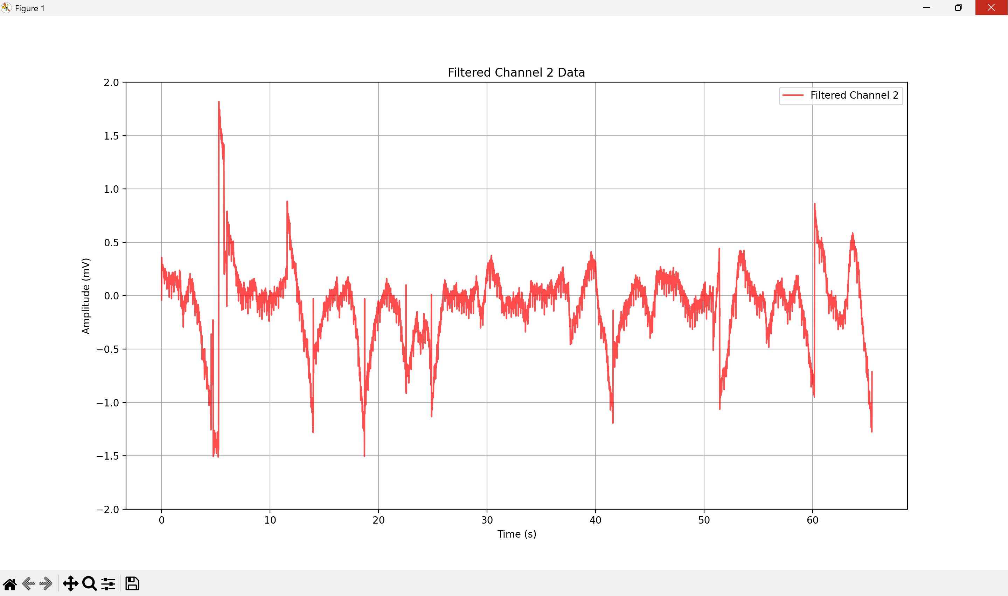
SDS00002.csv : Silence

Slide 6
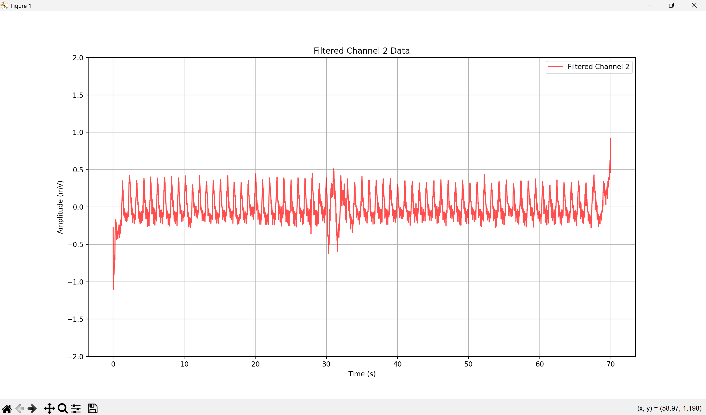
SDS00003.csv: Silence

Slide 7
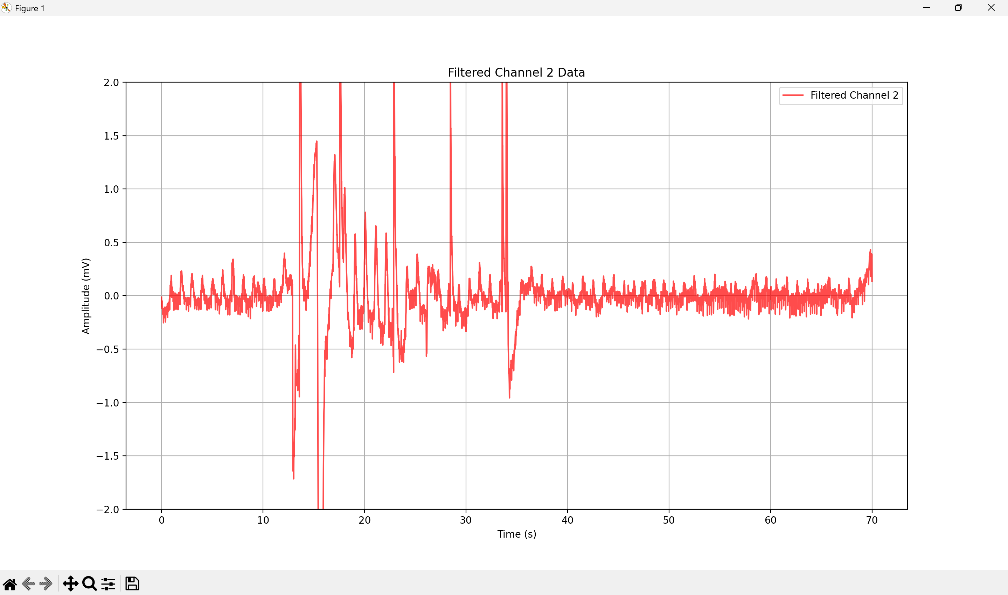
SDS00004.csv: Stir Whiskers

Slide 8
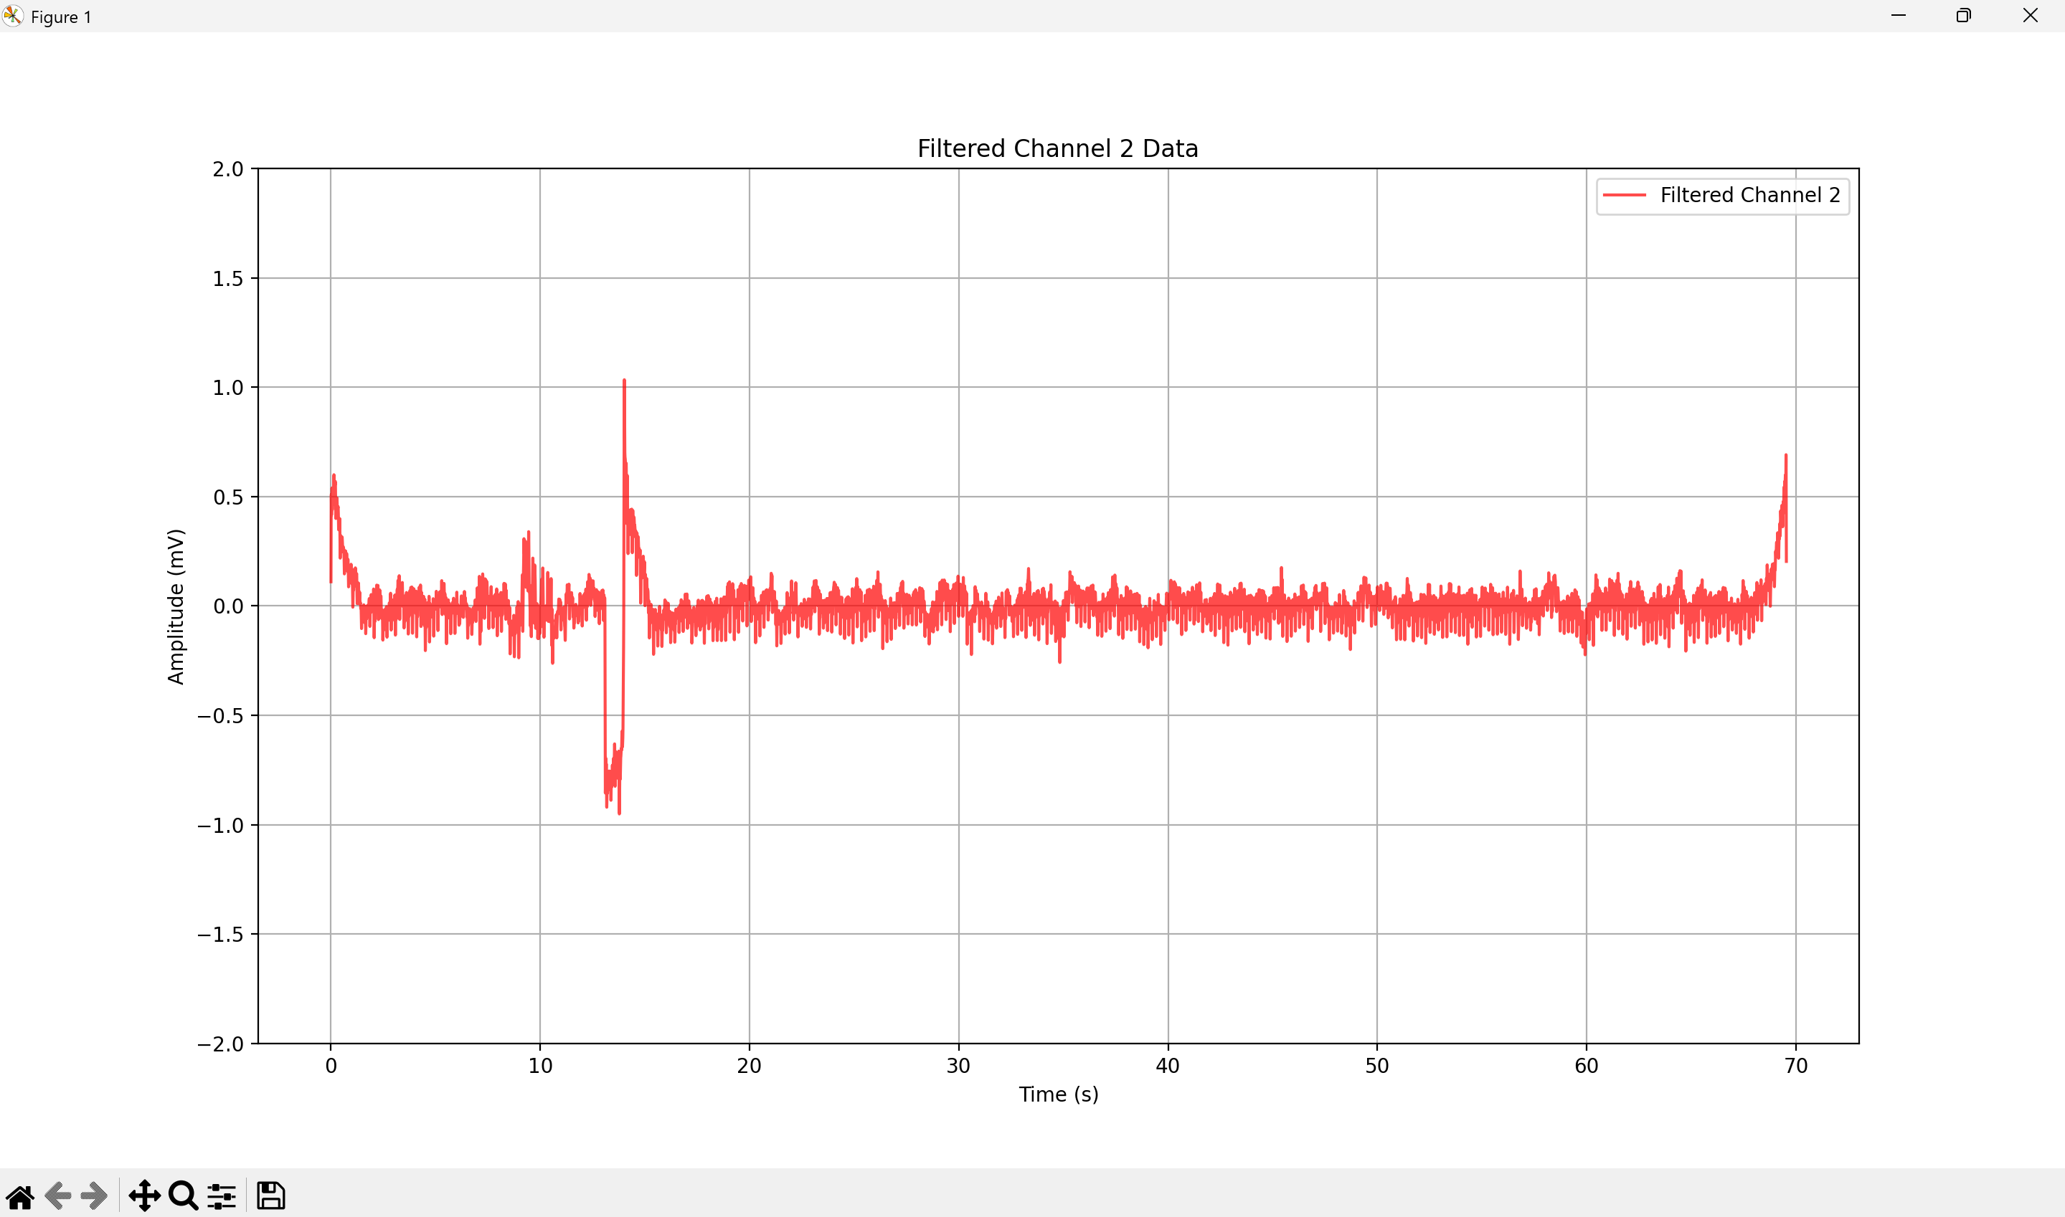
SDS00005.csv: Stir Whiskers

Slide 9
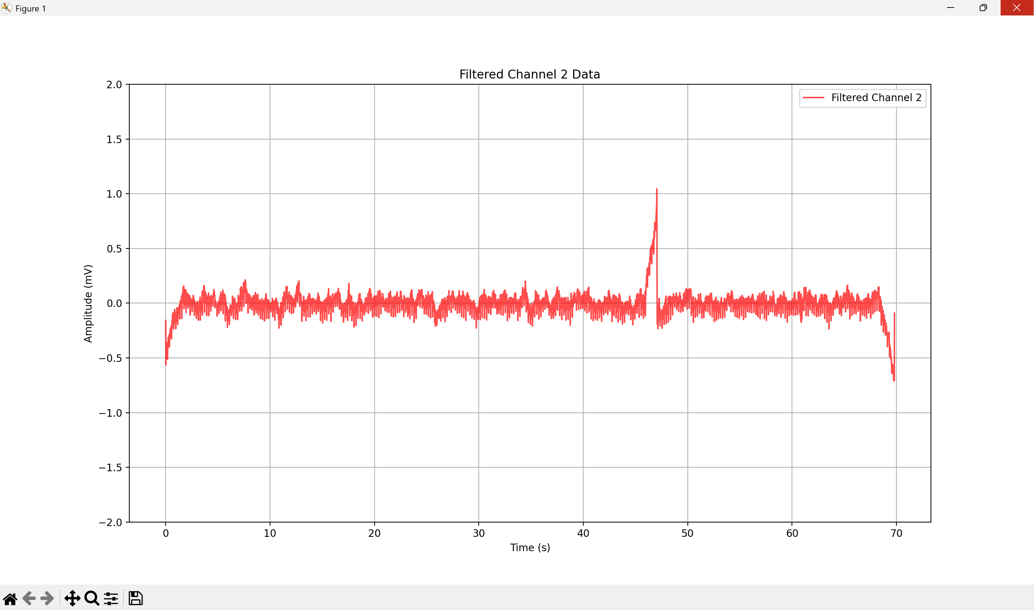
SDS00006.csv: Silence

Slide 10
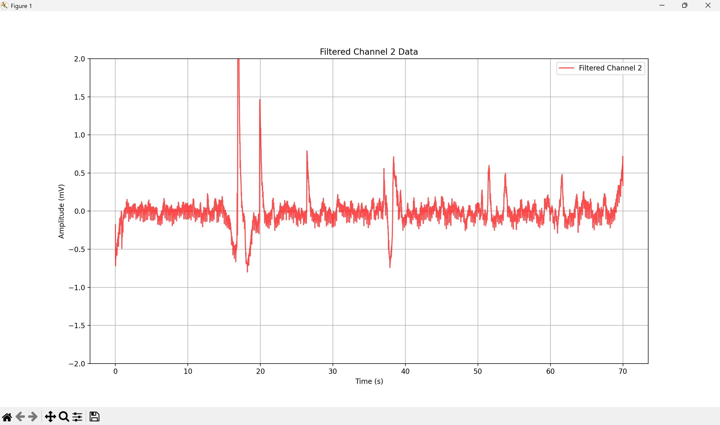
SDS00007.csv: Pinch Foot

Slide 11
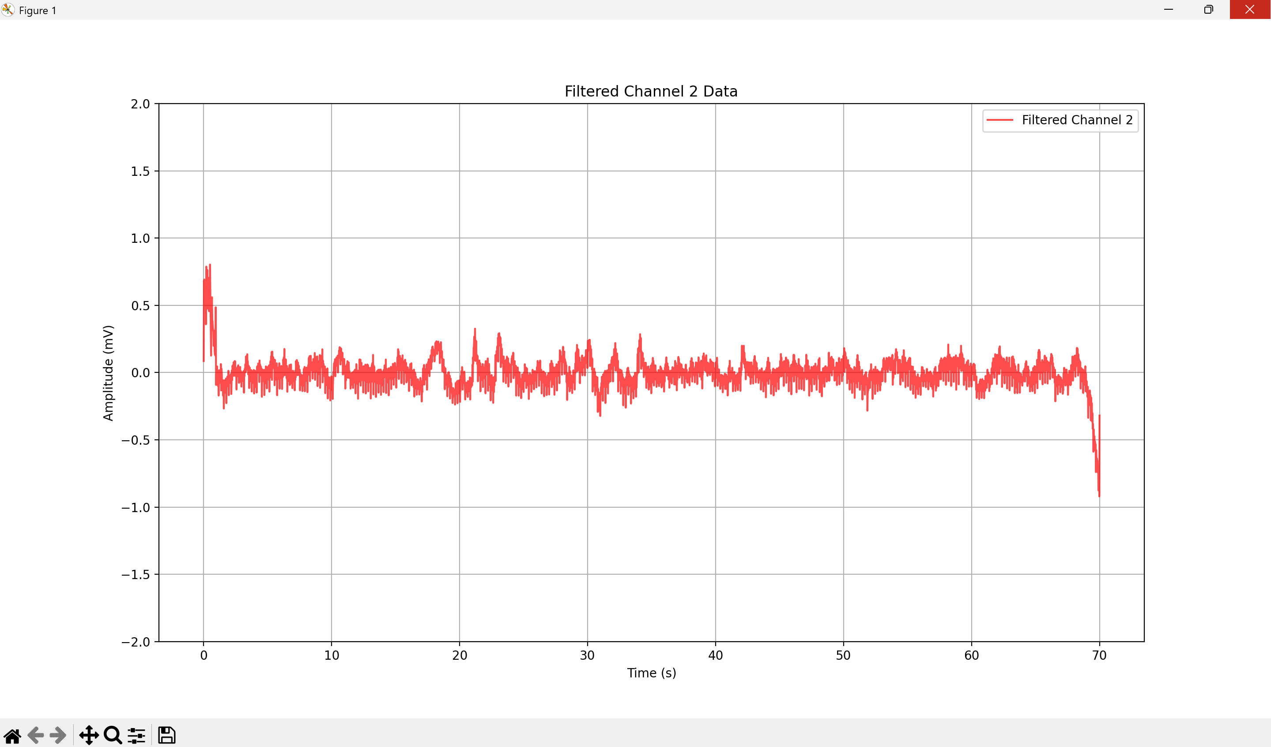
SDS00008.csv: Silence

Slide 12
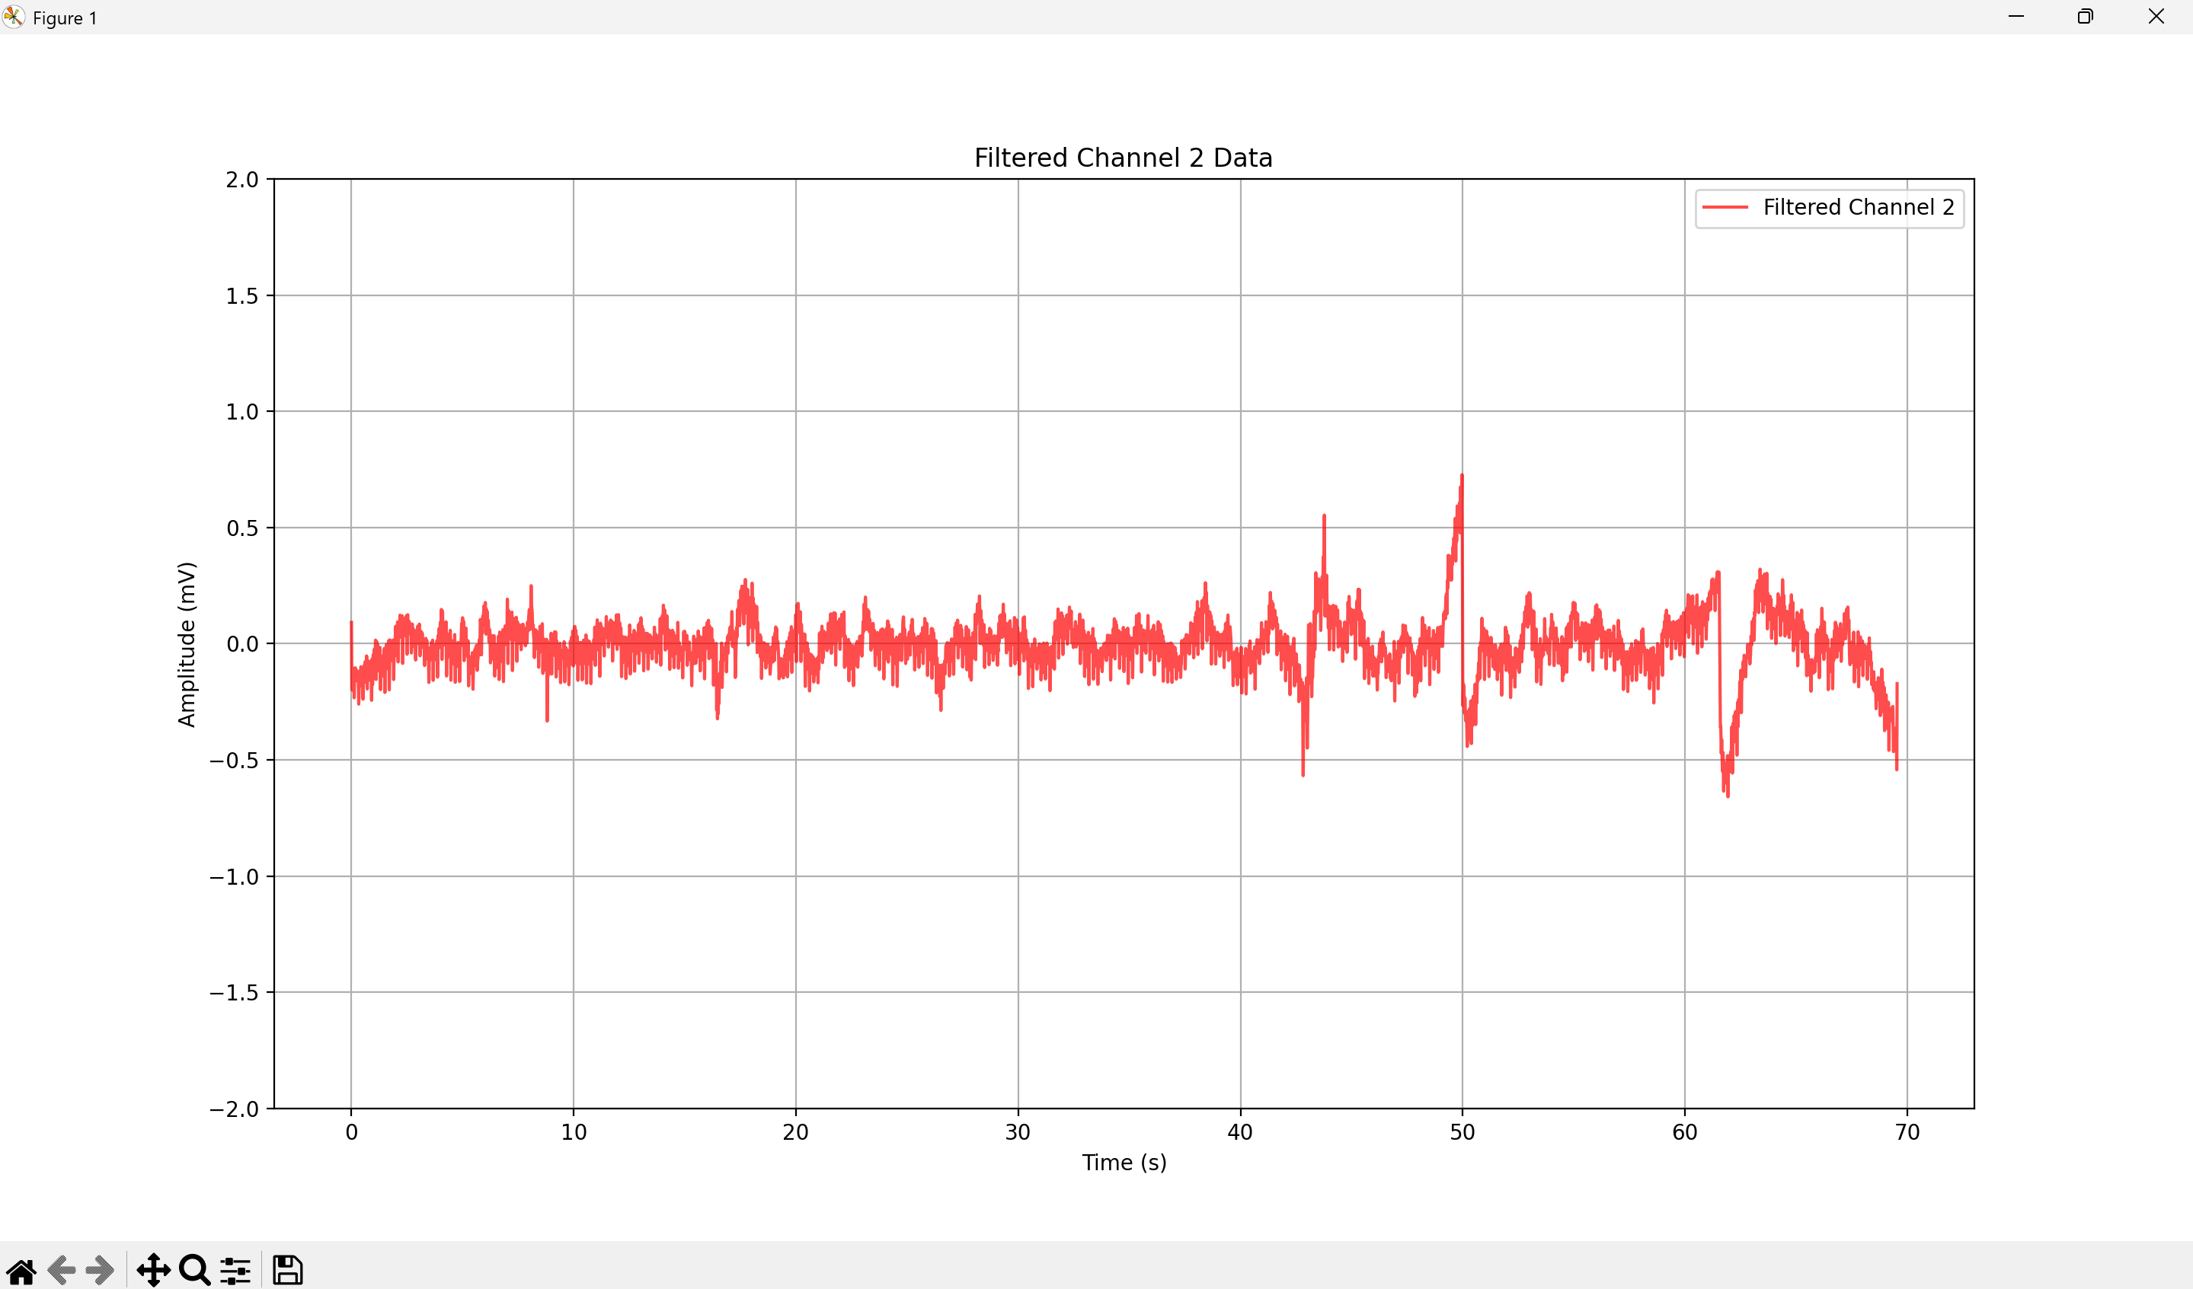
SDS00009.csv: Stir Whiskers

Slide 13
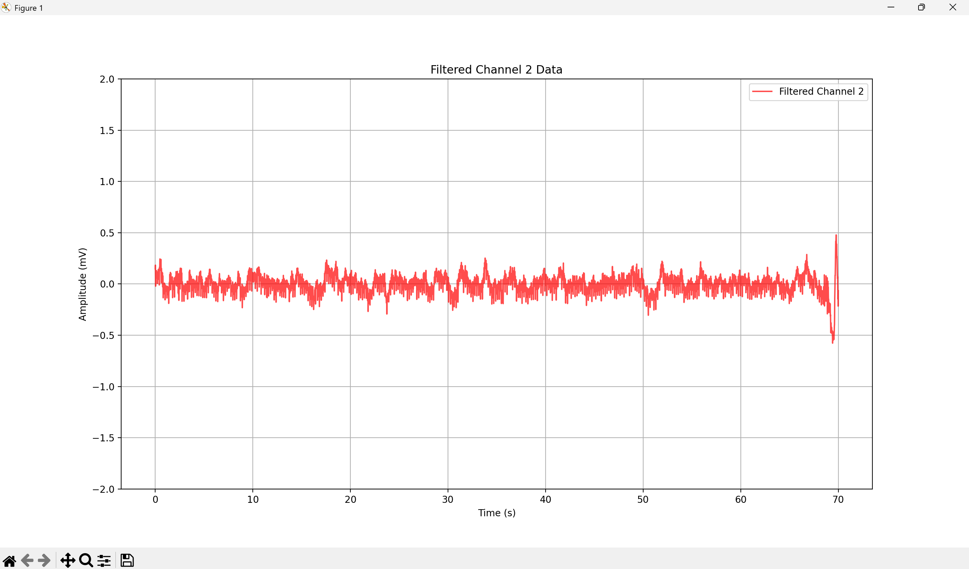
SDS00010.csv: Silence

Slide 14
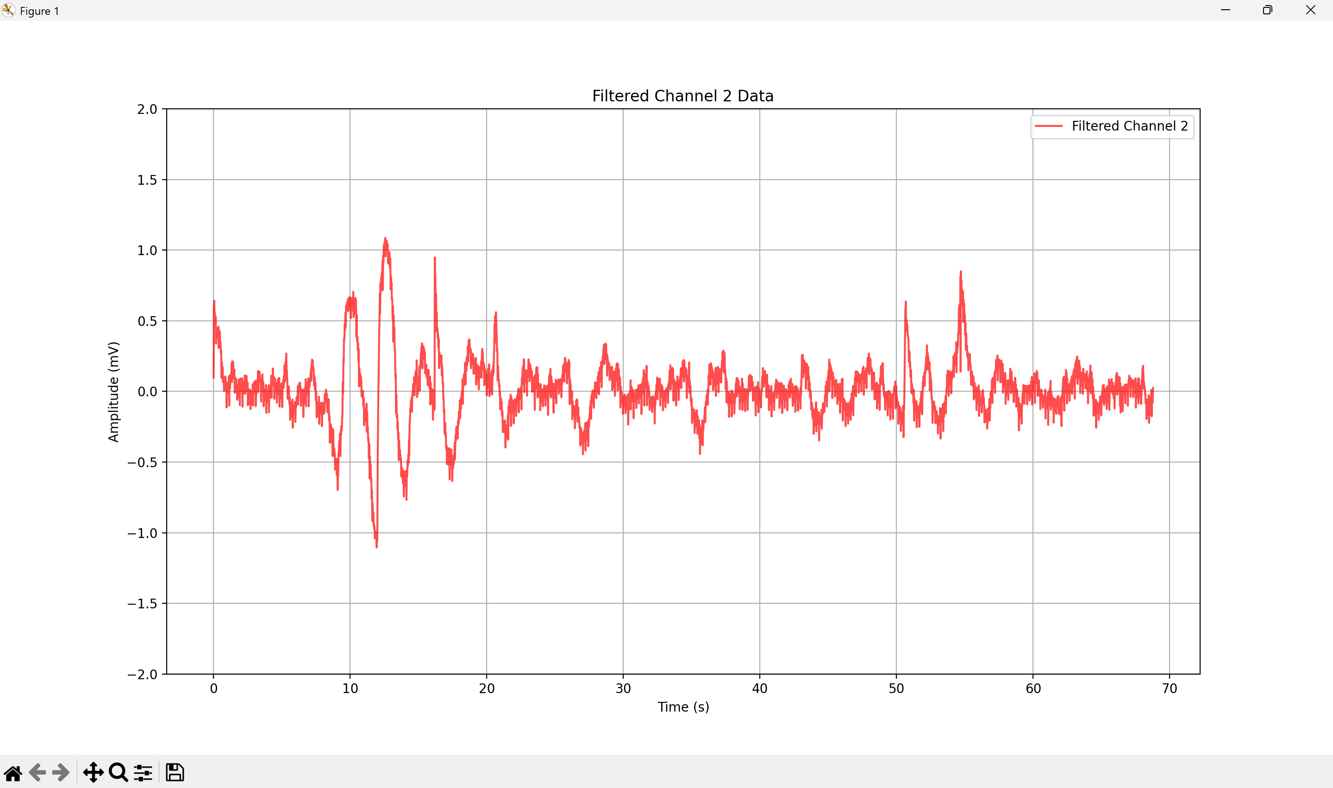
SDS00011.csv: Pinch Foot

Slide 15
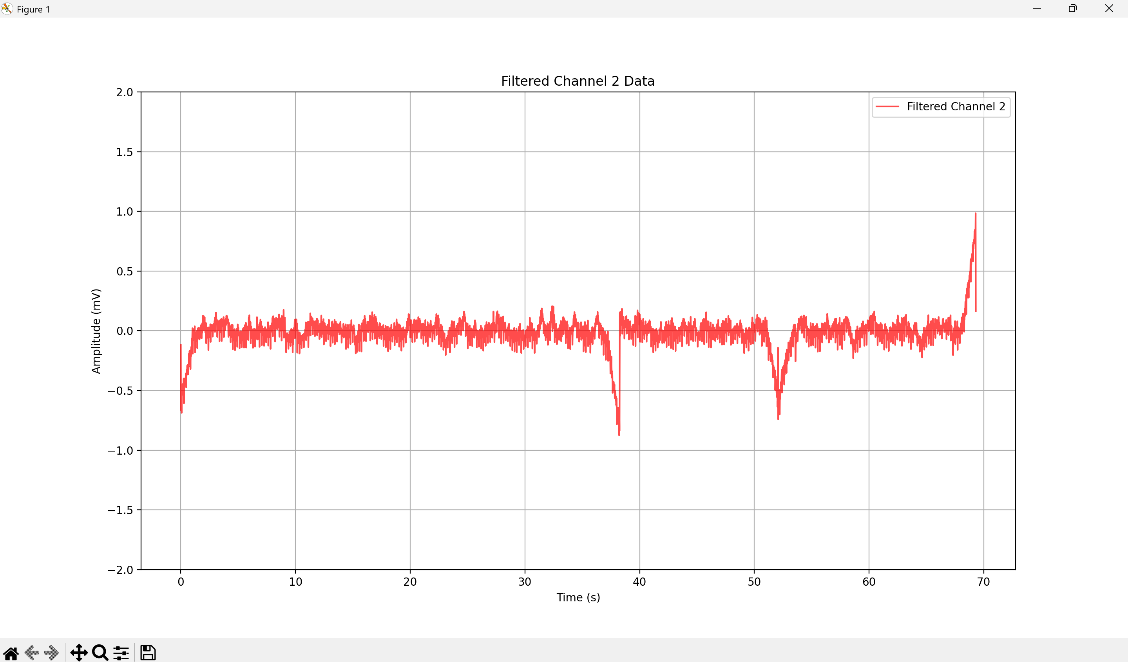
SDS00012.csv: Silence

Slide 16

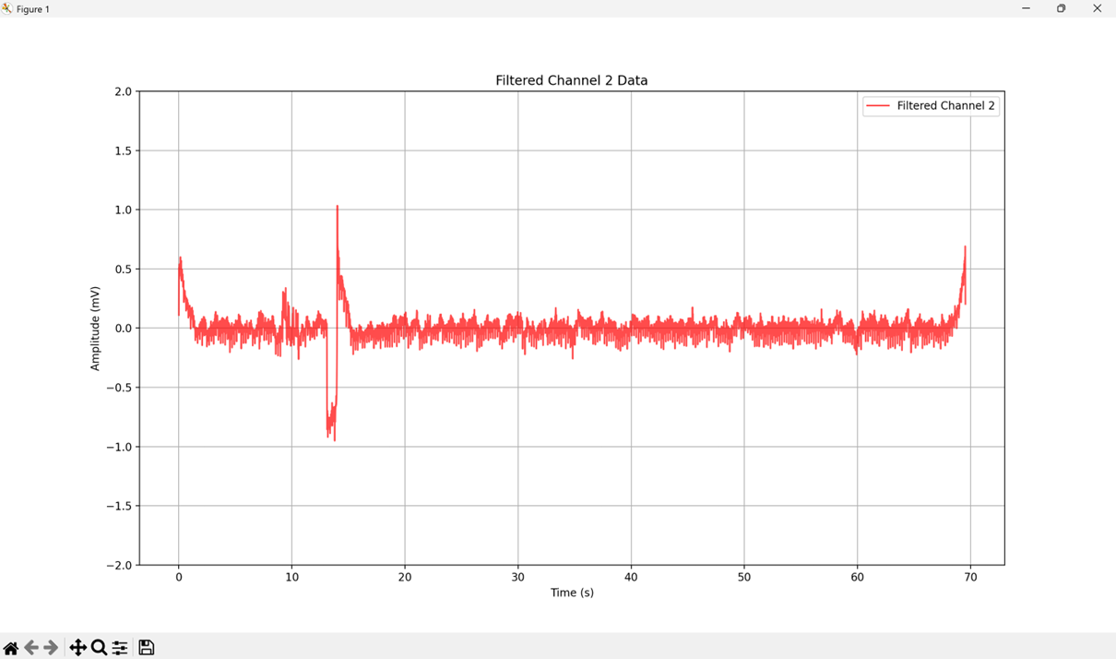
Compare Clean Silence and Stir Whiskers
Silence (SDS00010.csv)
Whisker (SDS00005.csv)

Slide 17

Compare Clean Silence and Foot Pinch
Silence (SDS00010.csv)
Pinch Foot (SDS00011.csv)

Slide 18
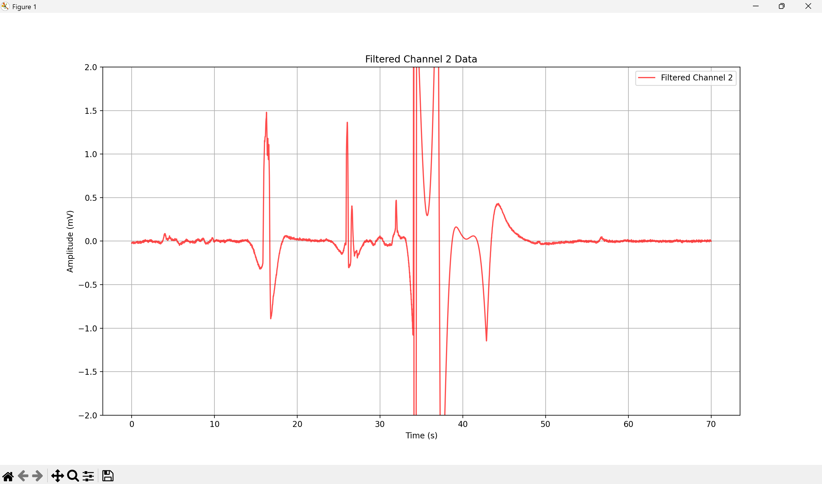
SDS00013.csv: No rat, just electrodes

Slide 19
Objective:
Plot a consistent and comparable TFR for all filtered datasets.
Methods:
Since the MNE library had no solution for creating consistent TFR plots, I used a new tool called ObsPy to create TFR plots that have a consistent scale.
This library is commonly used in earth sciences to plot seismological activity.
However, its ability to create visualizations of waves and create more detailed and customizable spectrograms makes it appealing.
Results:
The adjusted plots are shown in the following slides.
The plots are much more detailed and allow for a consistent scale, allowing them to be compared side by side.
Observation/Conclusion:
The silence recordings show more consistent results, with bands across recordings 3,6,8,10 and 12 at 5, 2, and 1 Hz.
Recording 2 does not share this similarity, but it was noted that this recording can be ignored.
The stirred whisker recordings also share these bands, but I am not yet sure if this is EEG activity or 60 Hz noise harmonics.
This is also reflected in the recordings where the foot was pinched repetitively.
Next Steps:
Understand how to differentiate between 60 Hz harmonics and EEG signals.

Slide 20
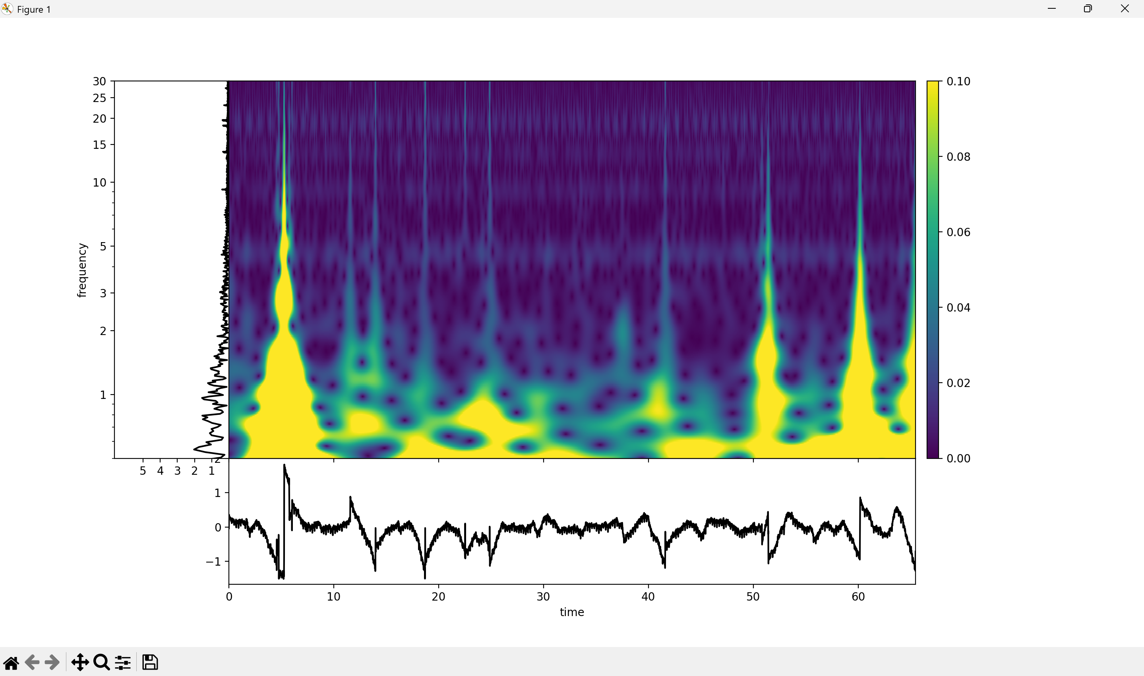
TFR of SDS00002.csv: Silence

Slide 21
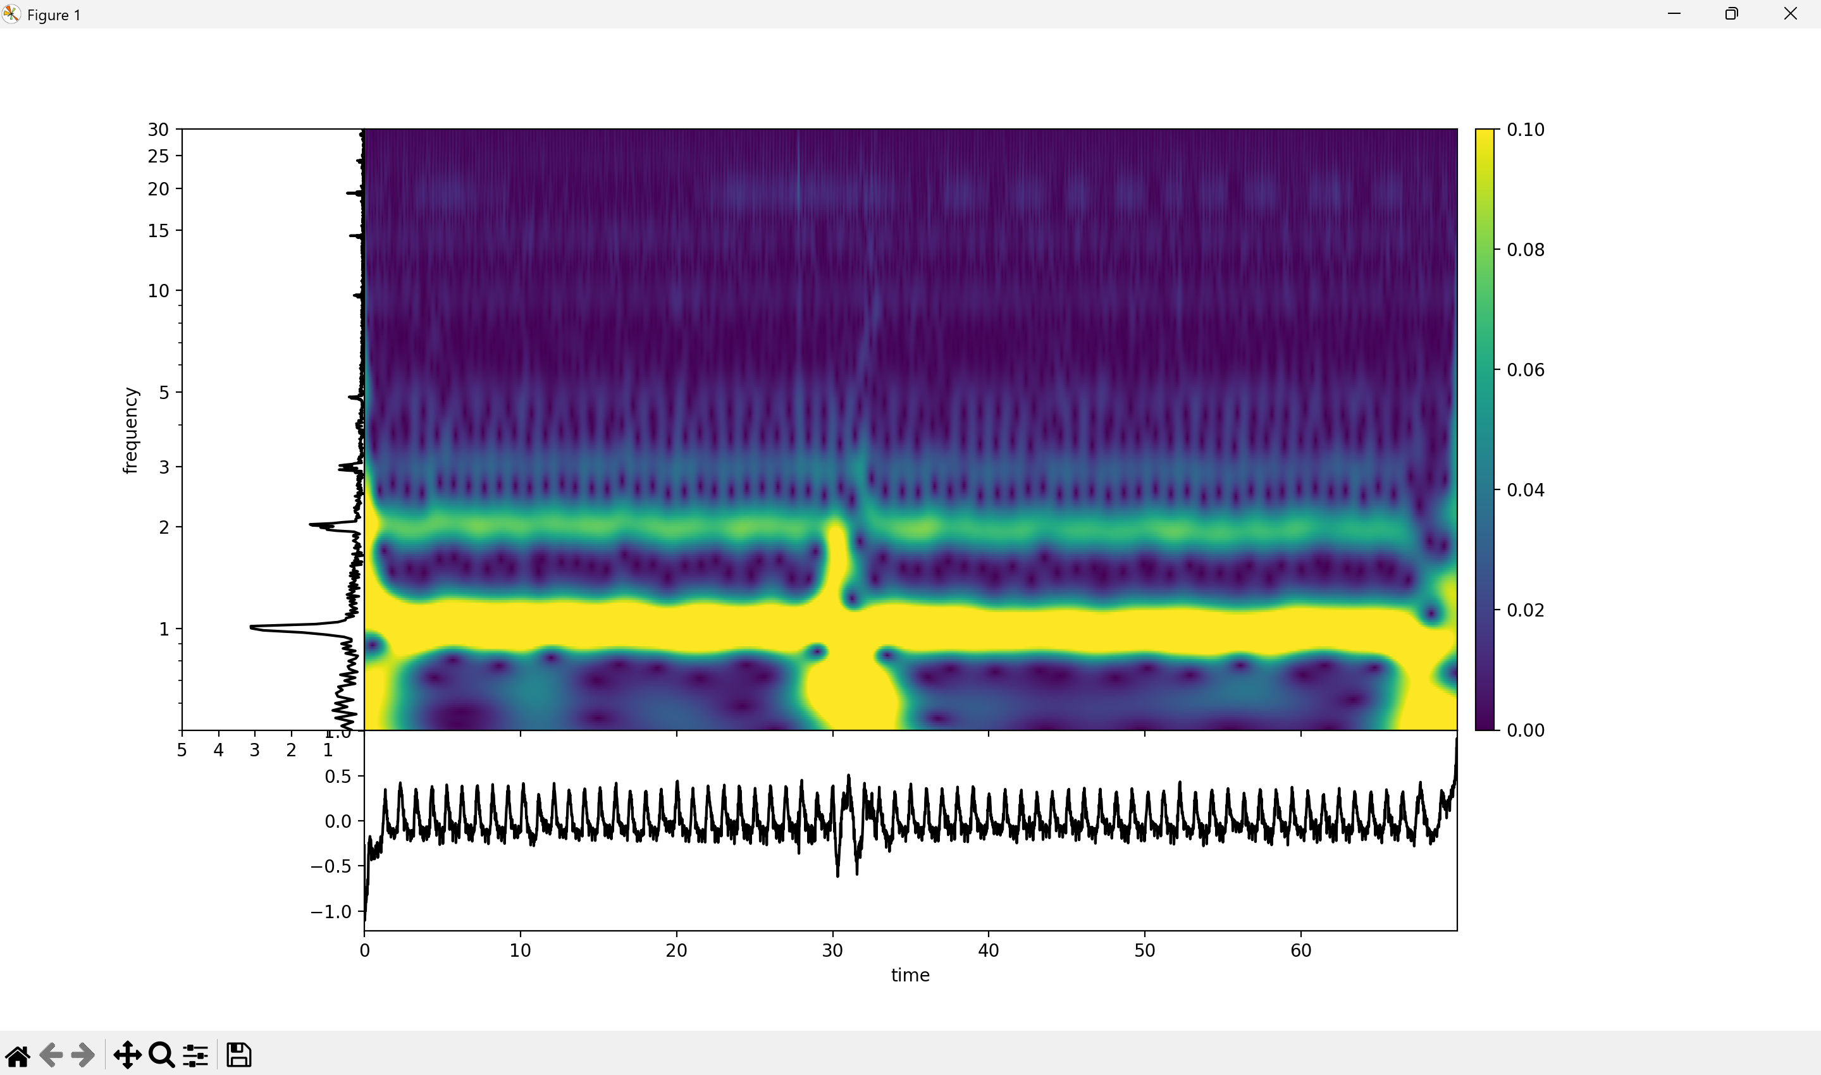
TFR of SDS00003.csv: Silence

Slide 22
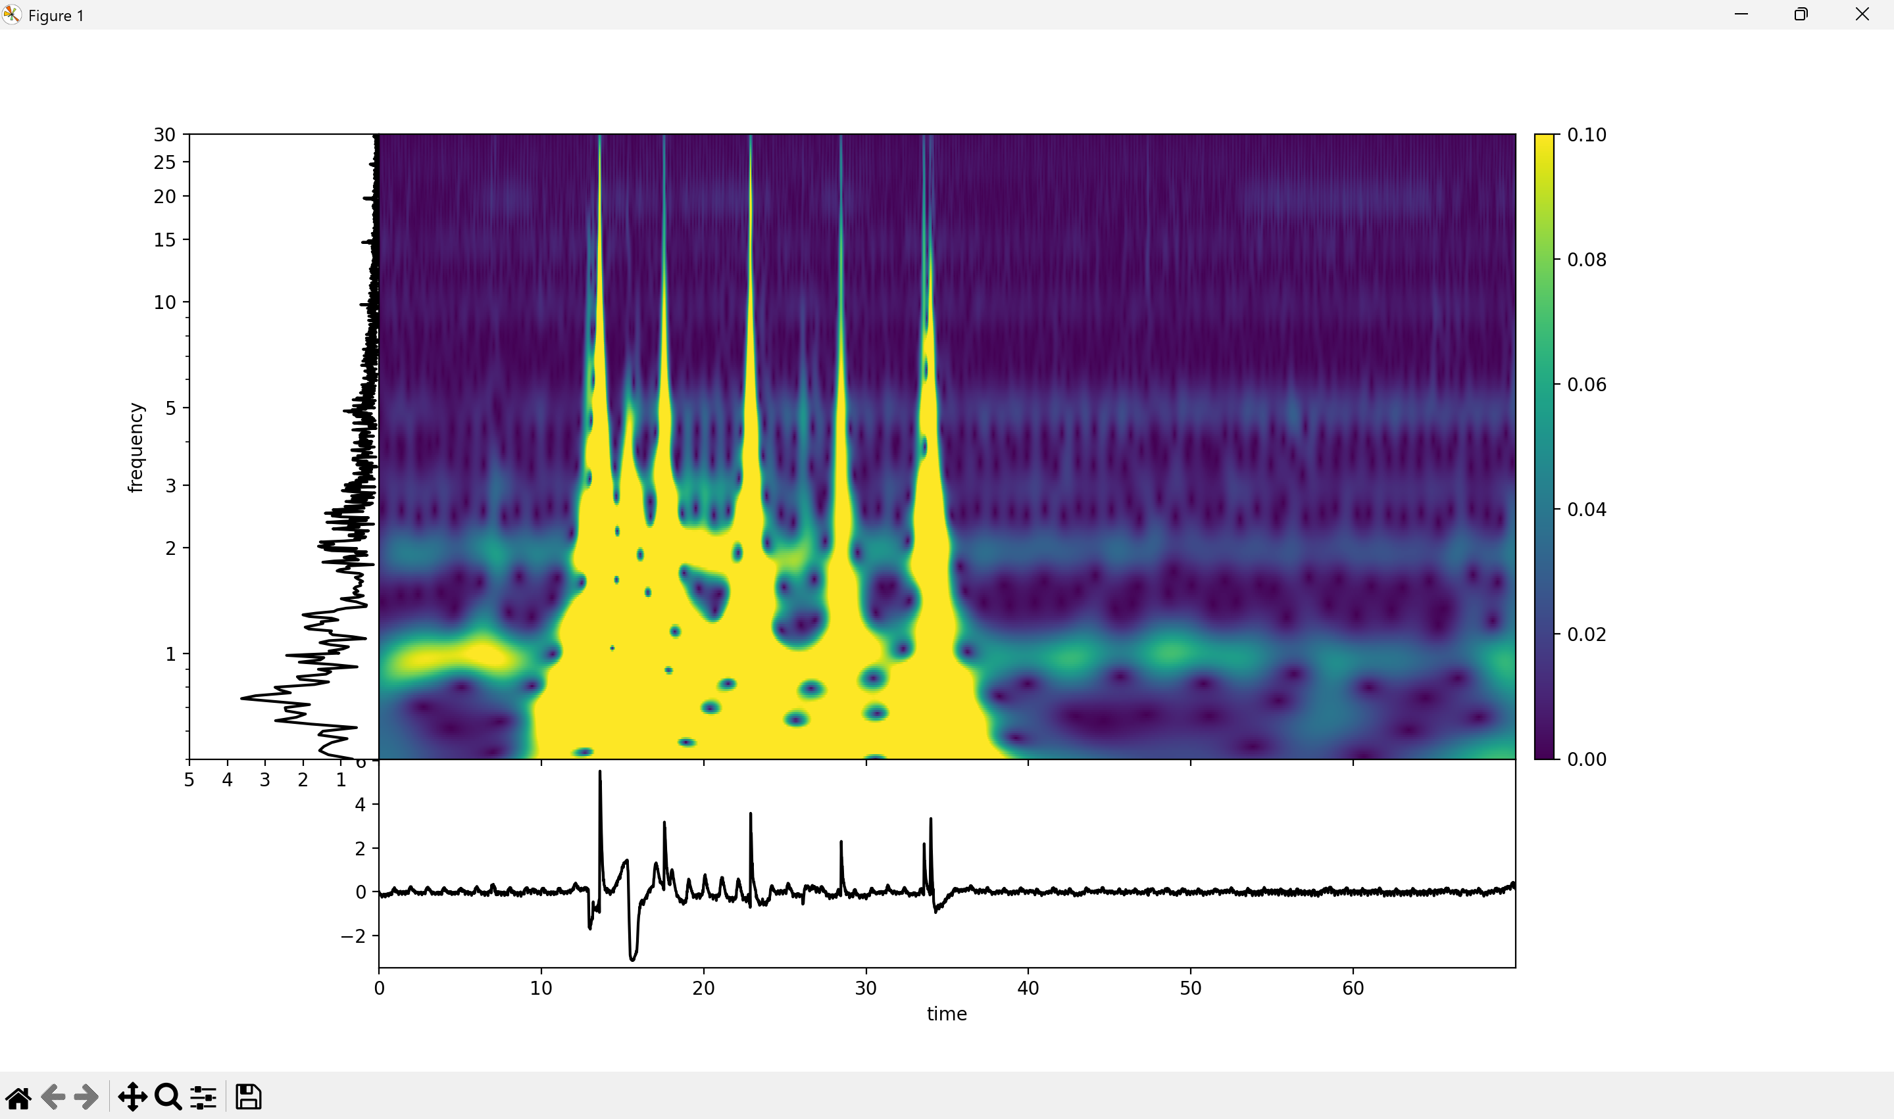
TFR of SDS00004.csv: Stir Whiskers

Slide 23
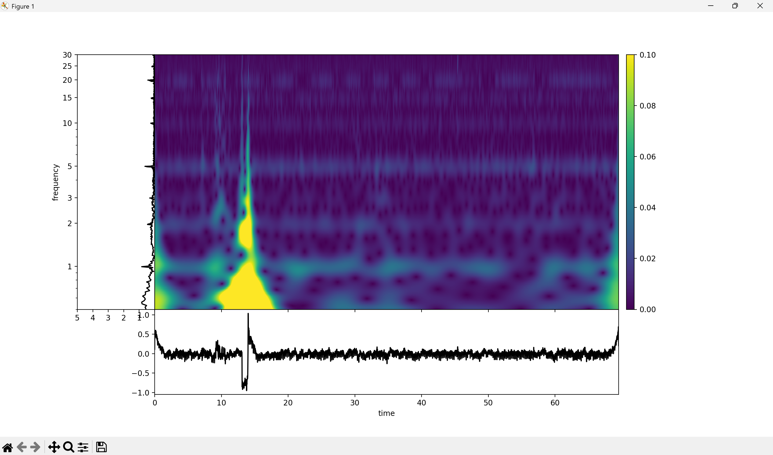
TFR of SDS00005.csv: Stir Whiskers

Slide 24
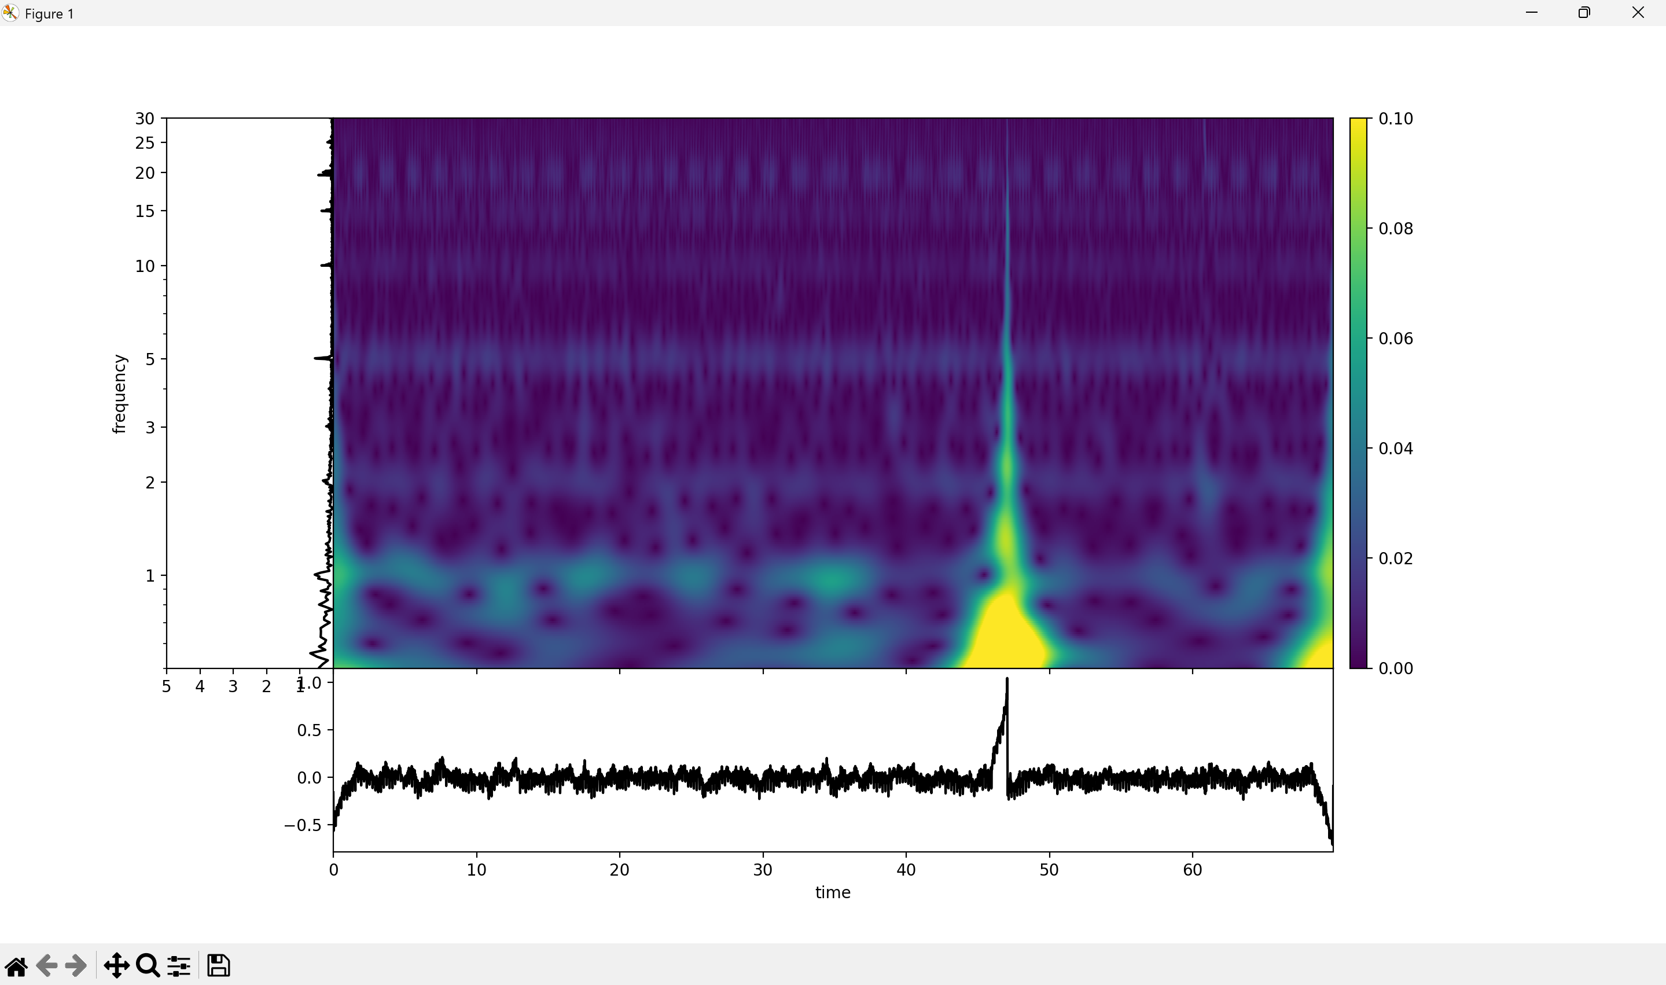
TFR of SDS00006.csv: Silence

Slide 25
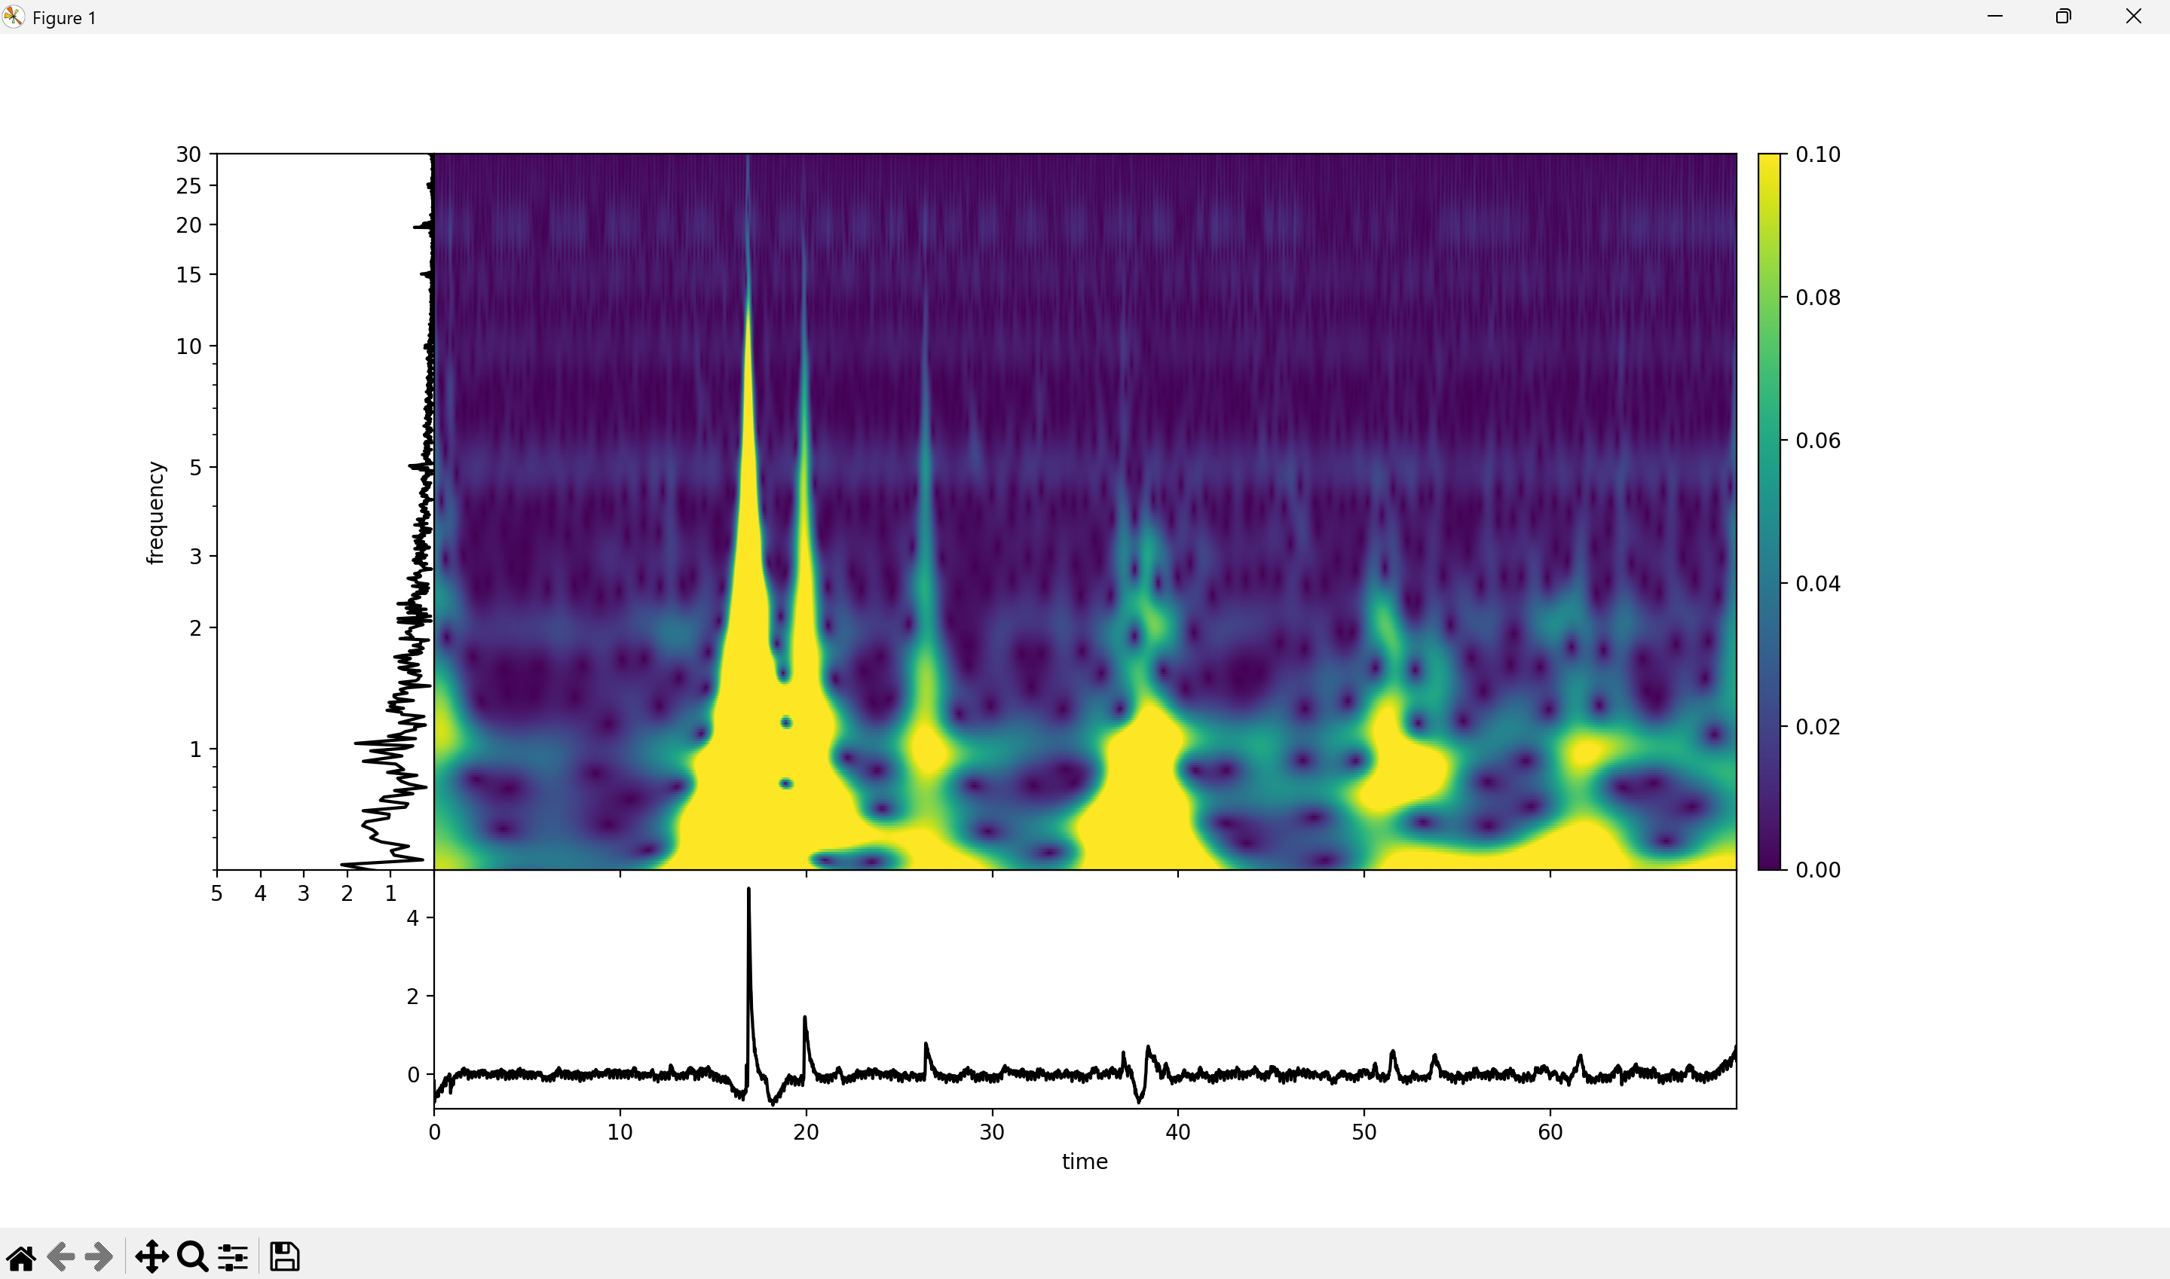
TFR of SDS00007.csv: Foot Pinch

Slide 26
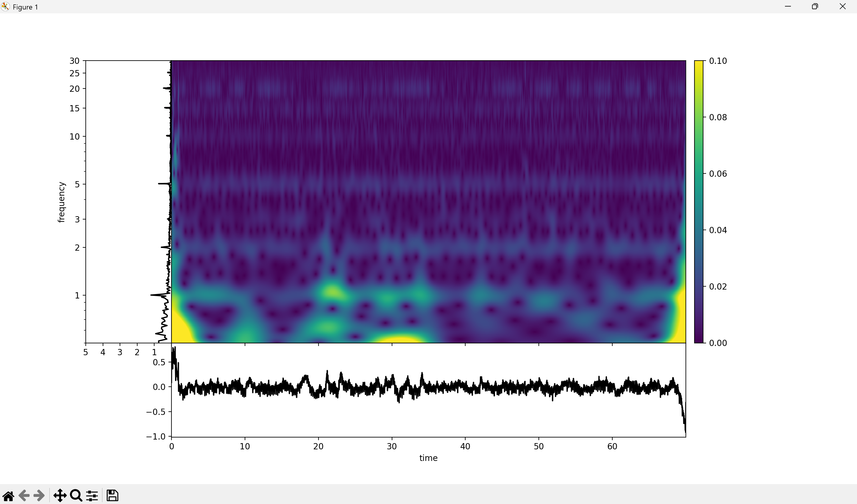
TFR SDS00008.csv: Silence

Slide 27
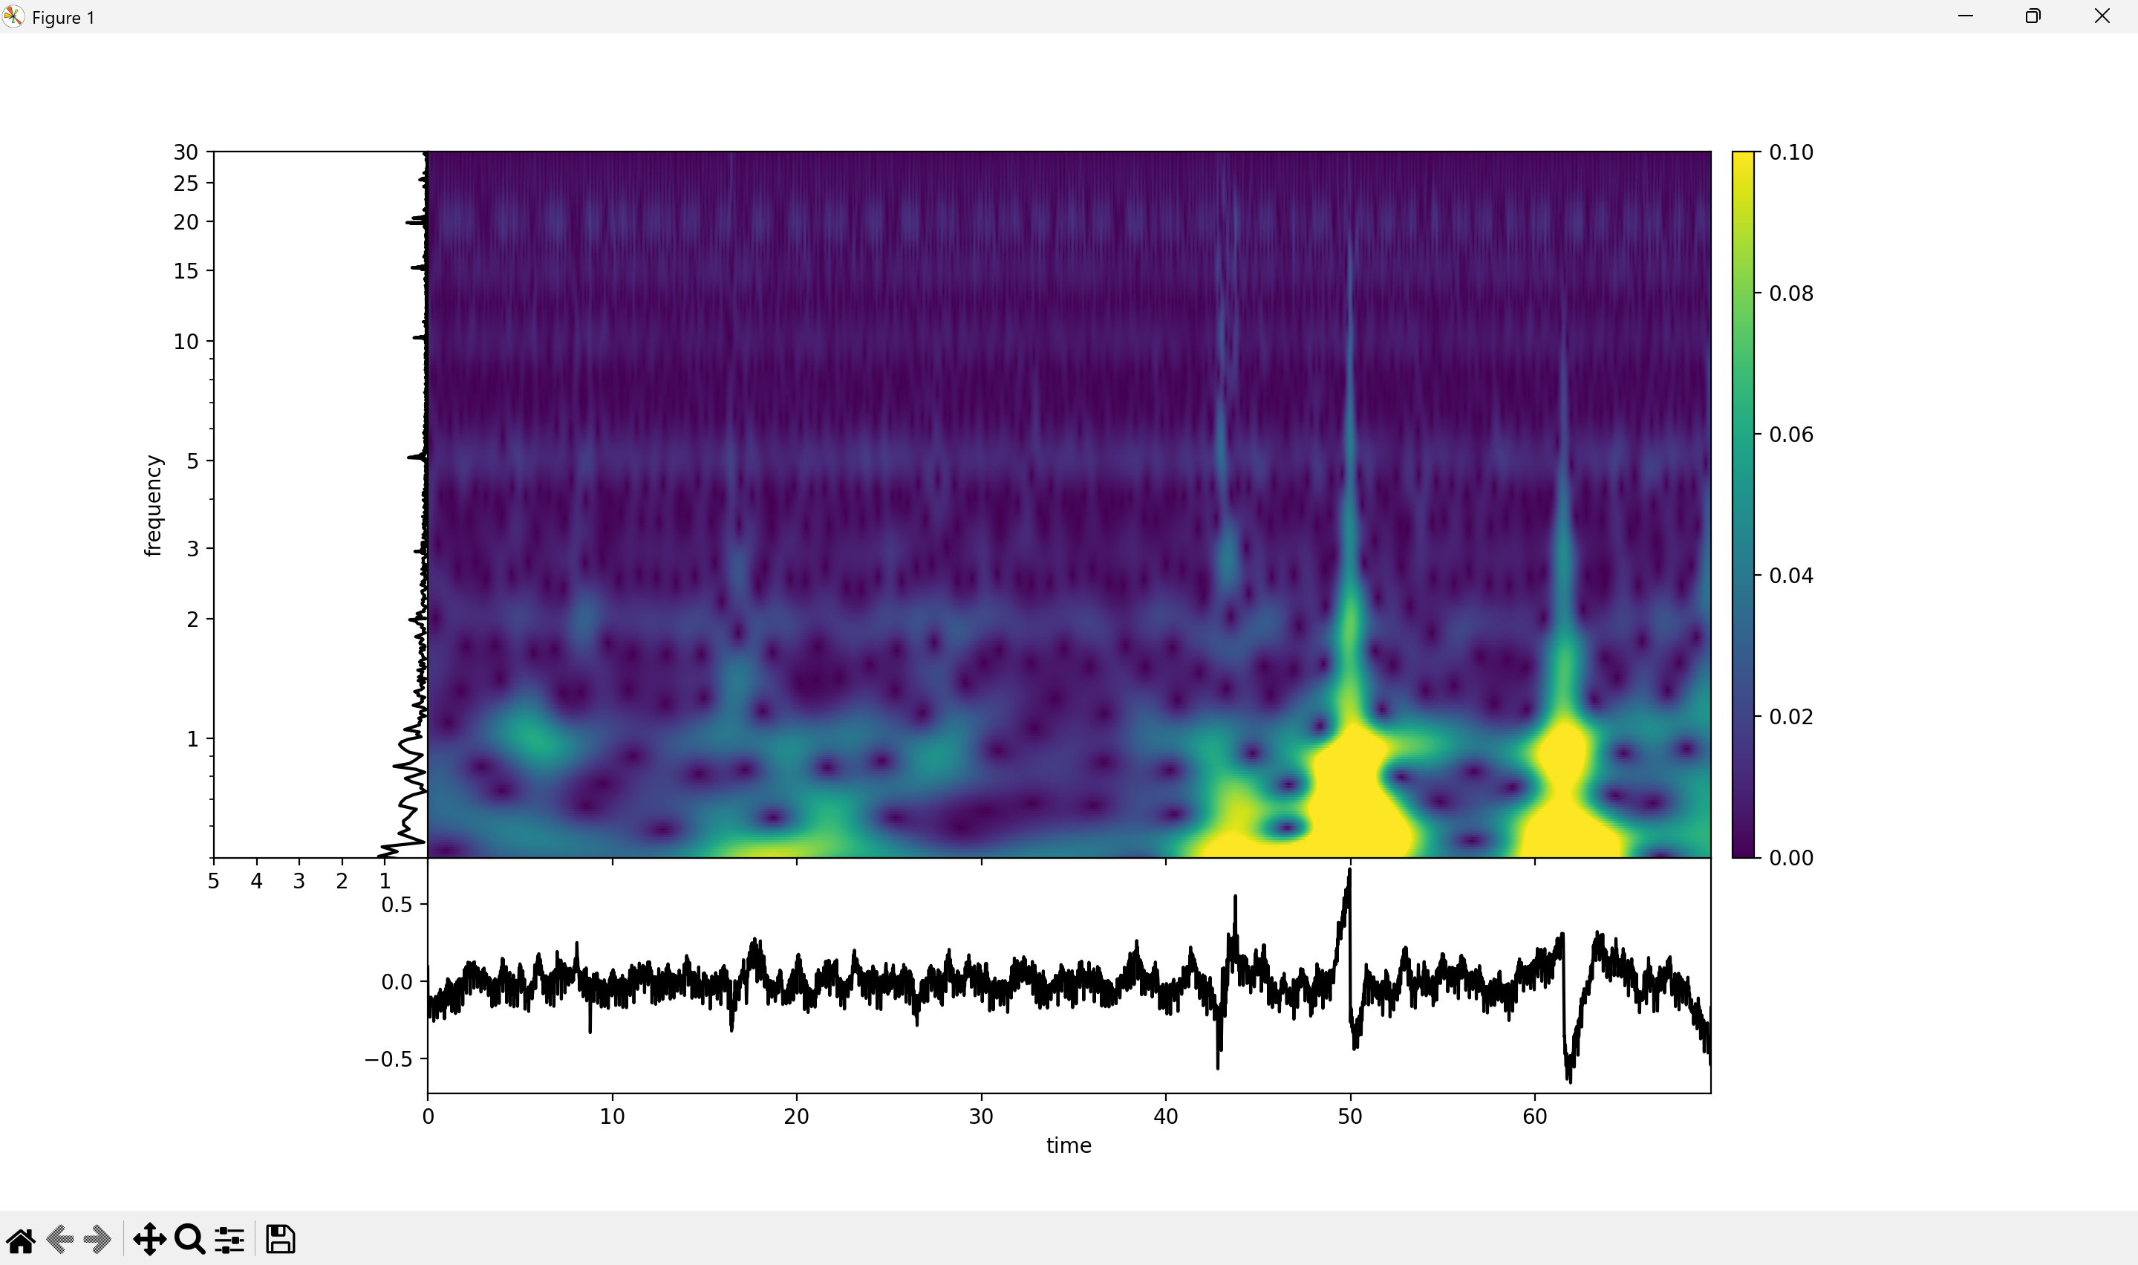
TFR SDS00009.csv: Stir Whiskers

Slide 28
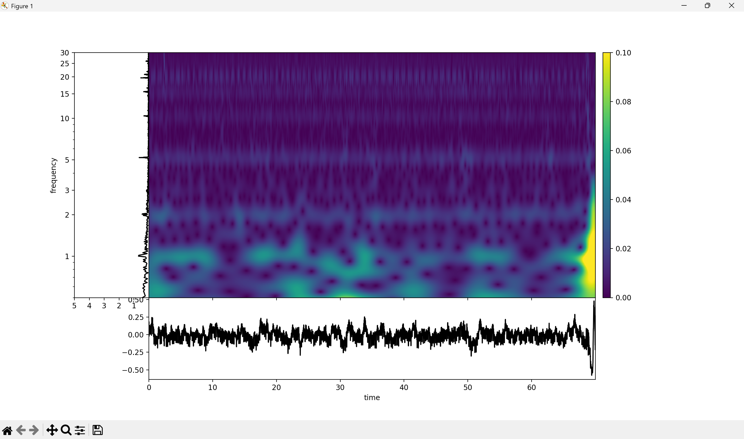
TFR of SDS00010.csv: Silence

Slide 29
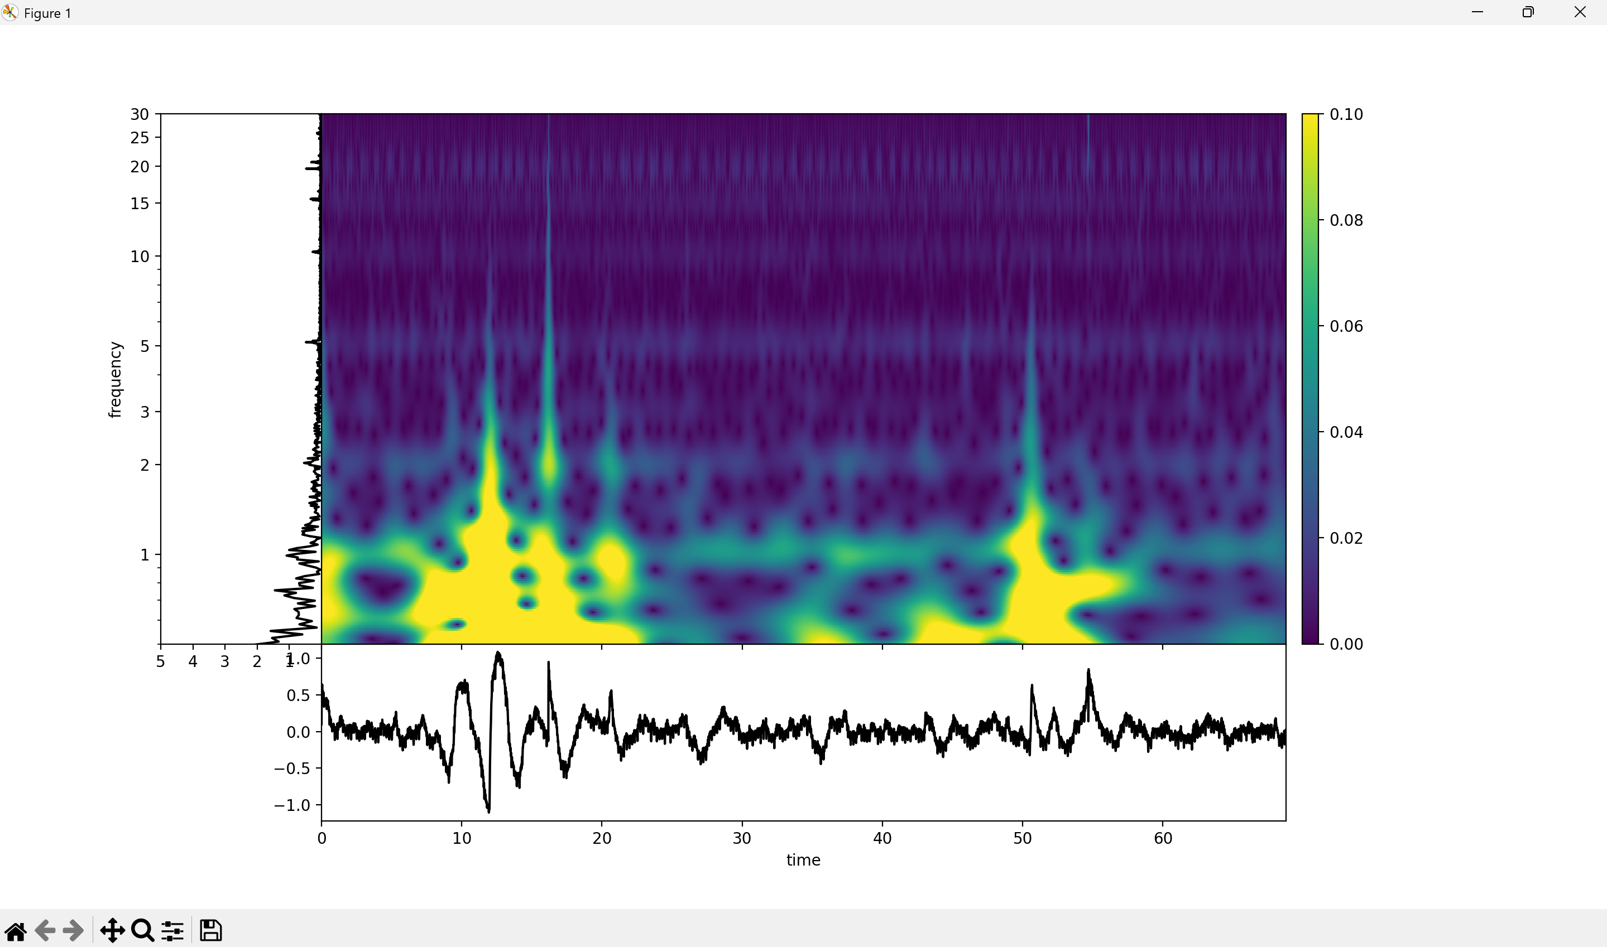
TFR of SDS00011.csv: Foot Pinch

Slide 30
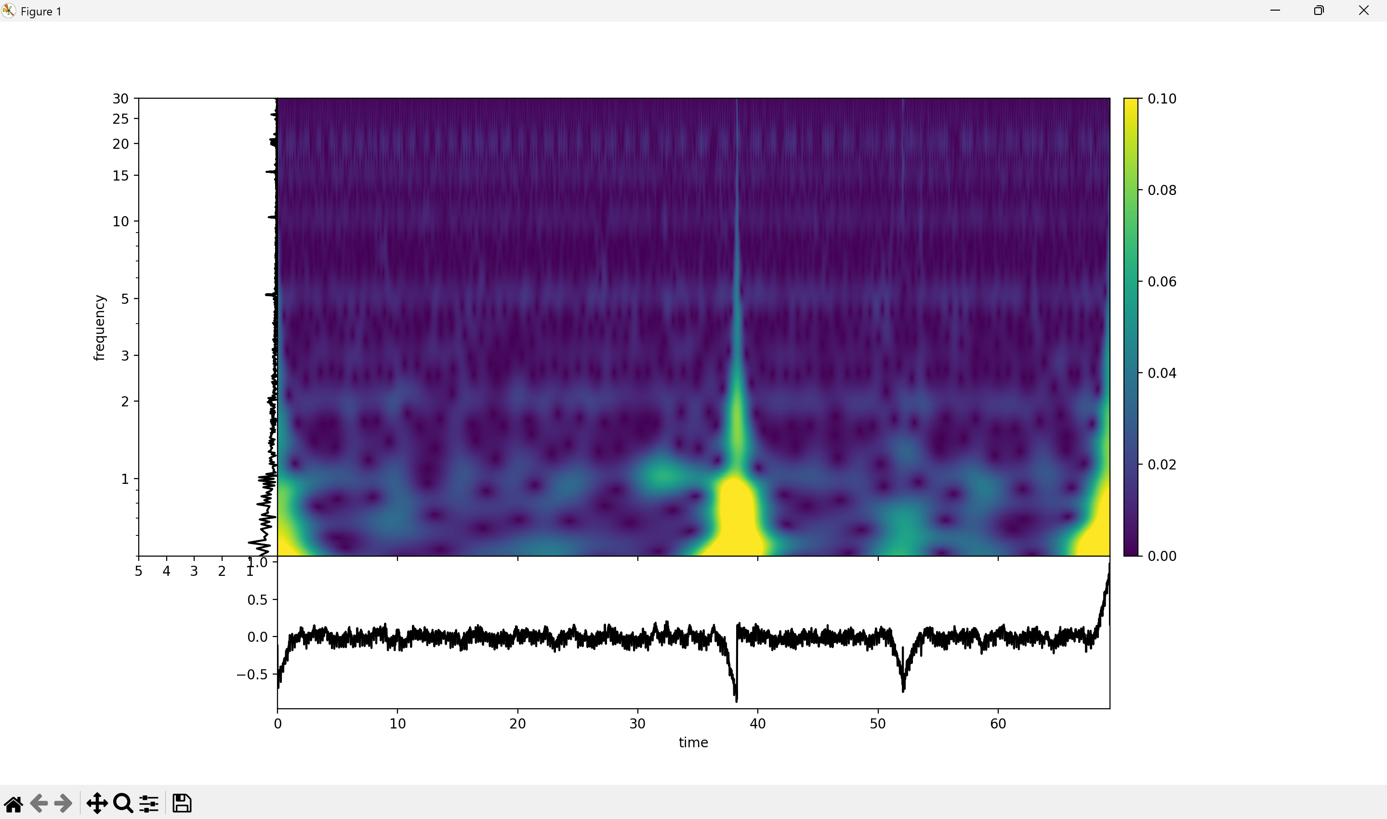
TFR of SDS00012.csv: Silence

Slide 31
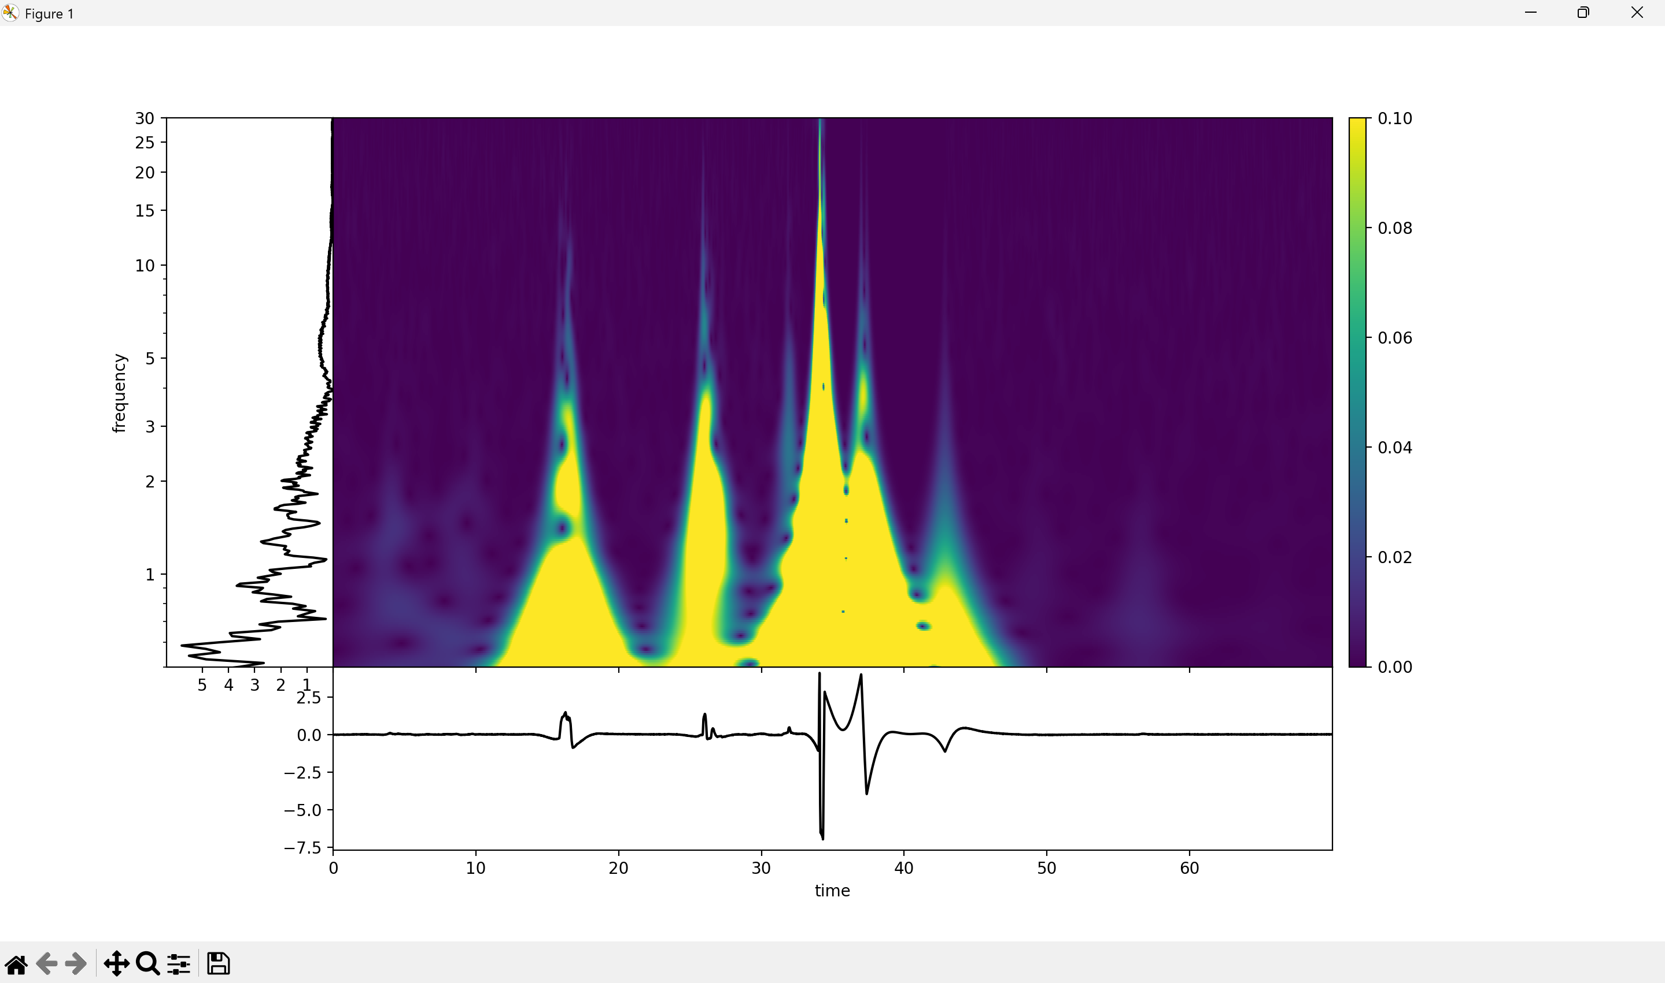
TFR of SDS00013.csv: No rat, just electrodes

Slide 32
Compare Silence
SDS00002.CSV
SDS00003.CSV
SDS00006.CSV
SDS00005.csv
SDS00008.CSV
SDS00010.CSV
SDS00012.CSV

Slide 33
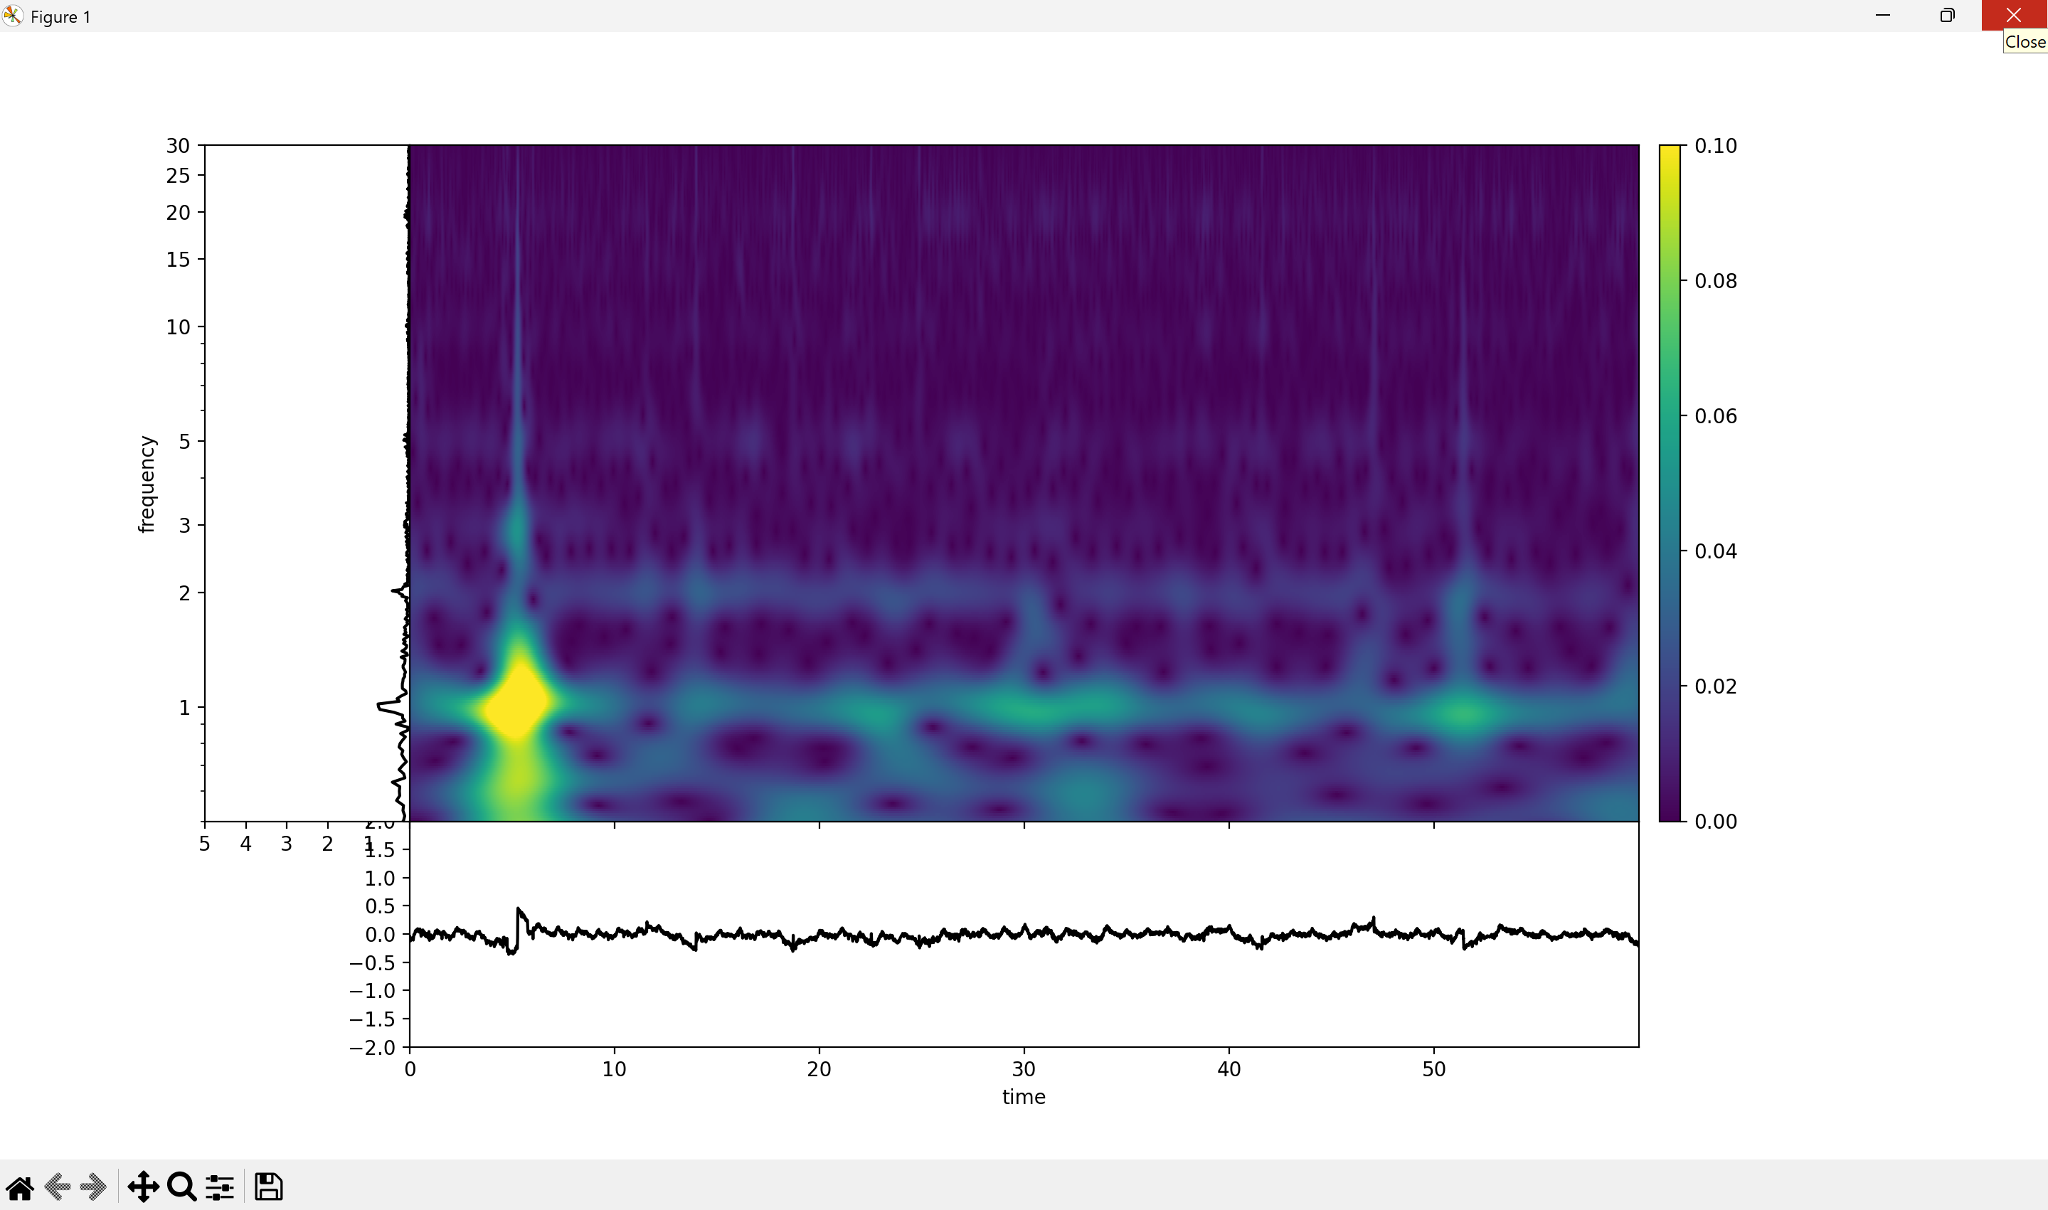
Average Silence TFR

Slide 34
Compare Stir Whiskers
SDS00004.csv
SDS00005.csv
SDS00009.csv

Slide 35
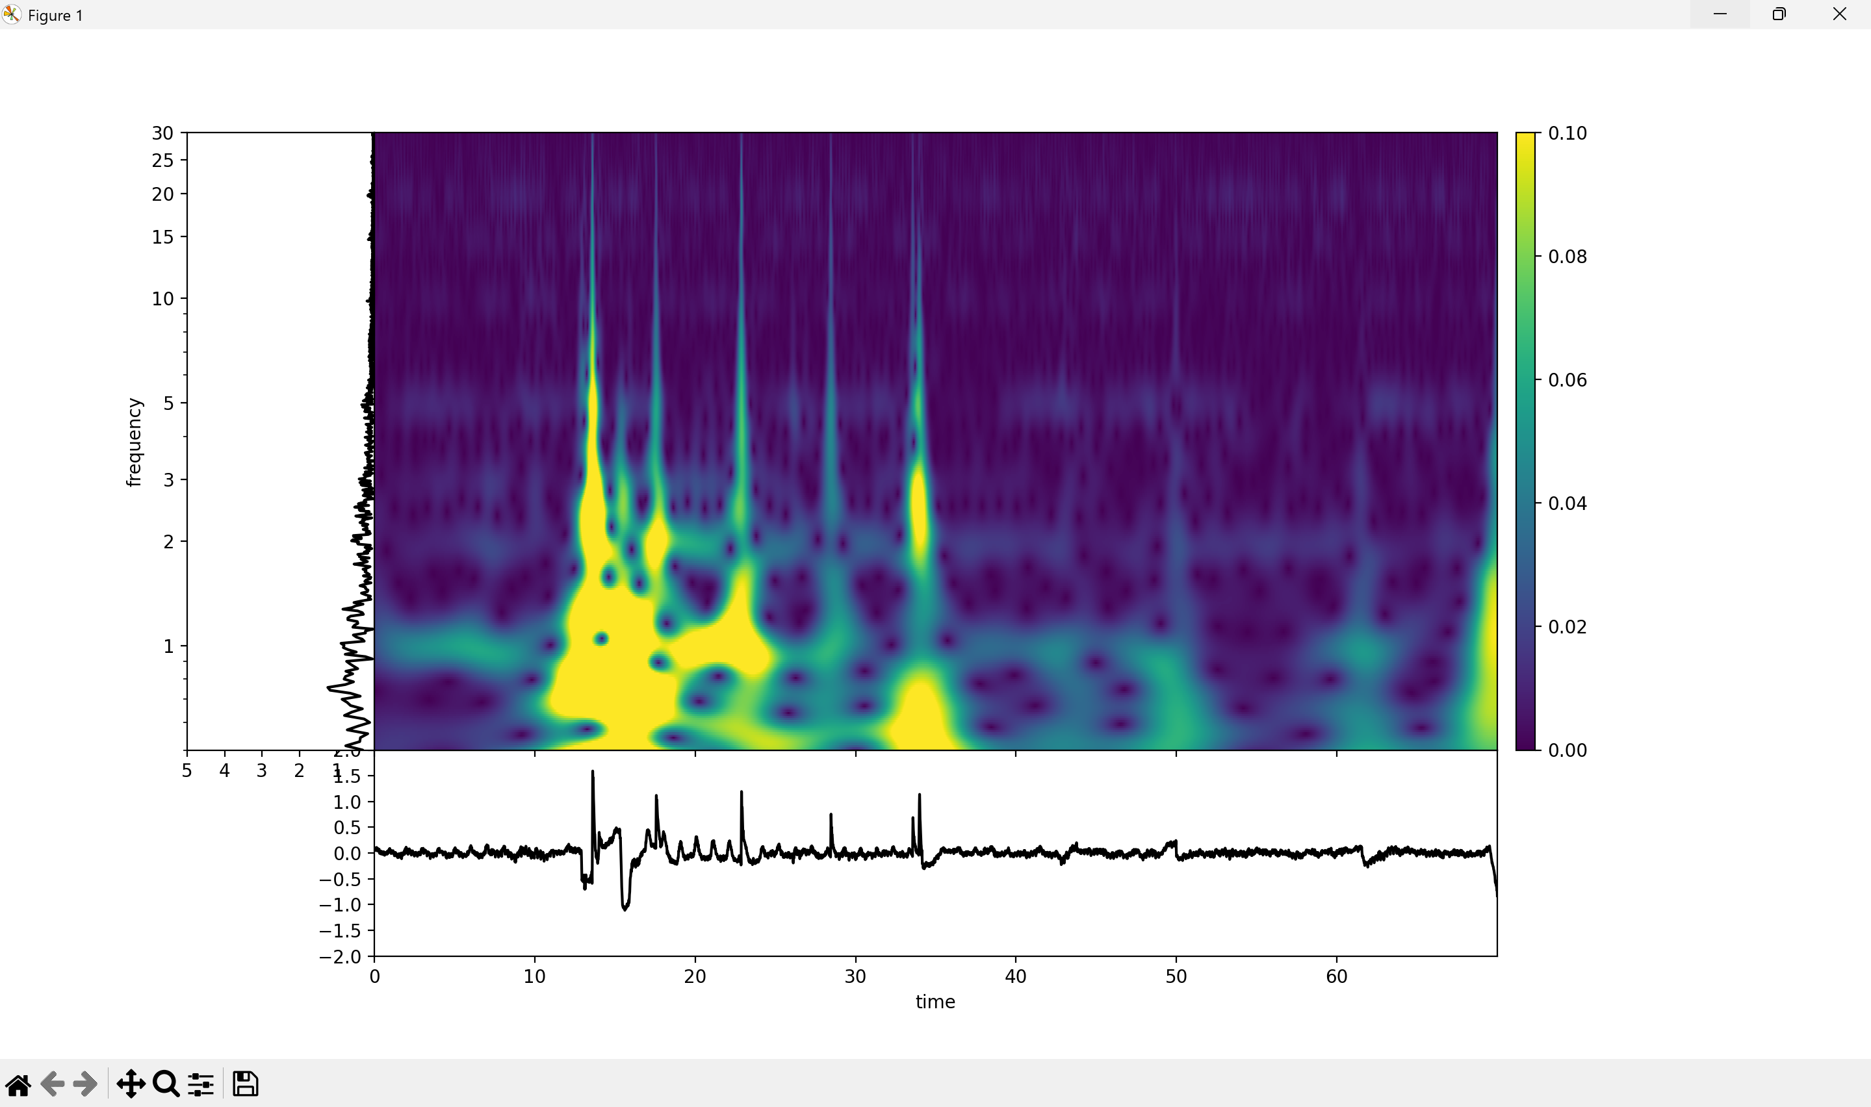
Average Whisker TFR

Slide 36
Compare Foot Pinch:
SDS00007.csv
SDS00011.csv

Slide 37
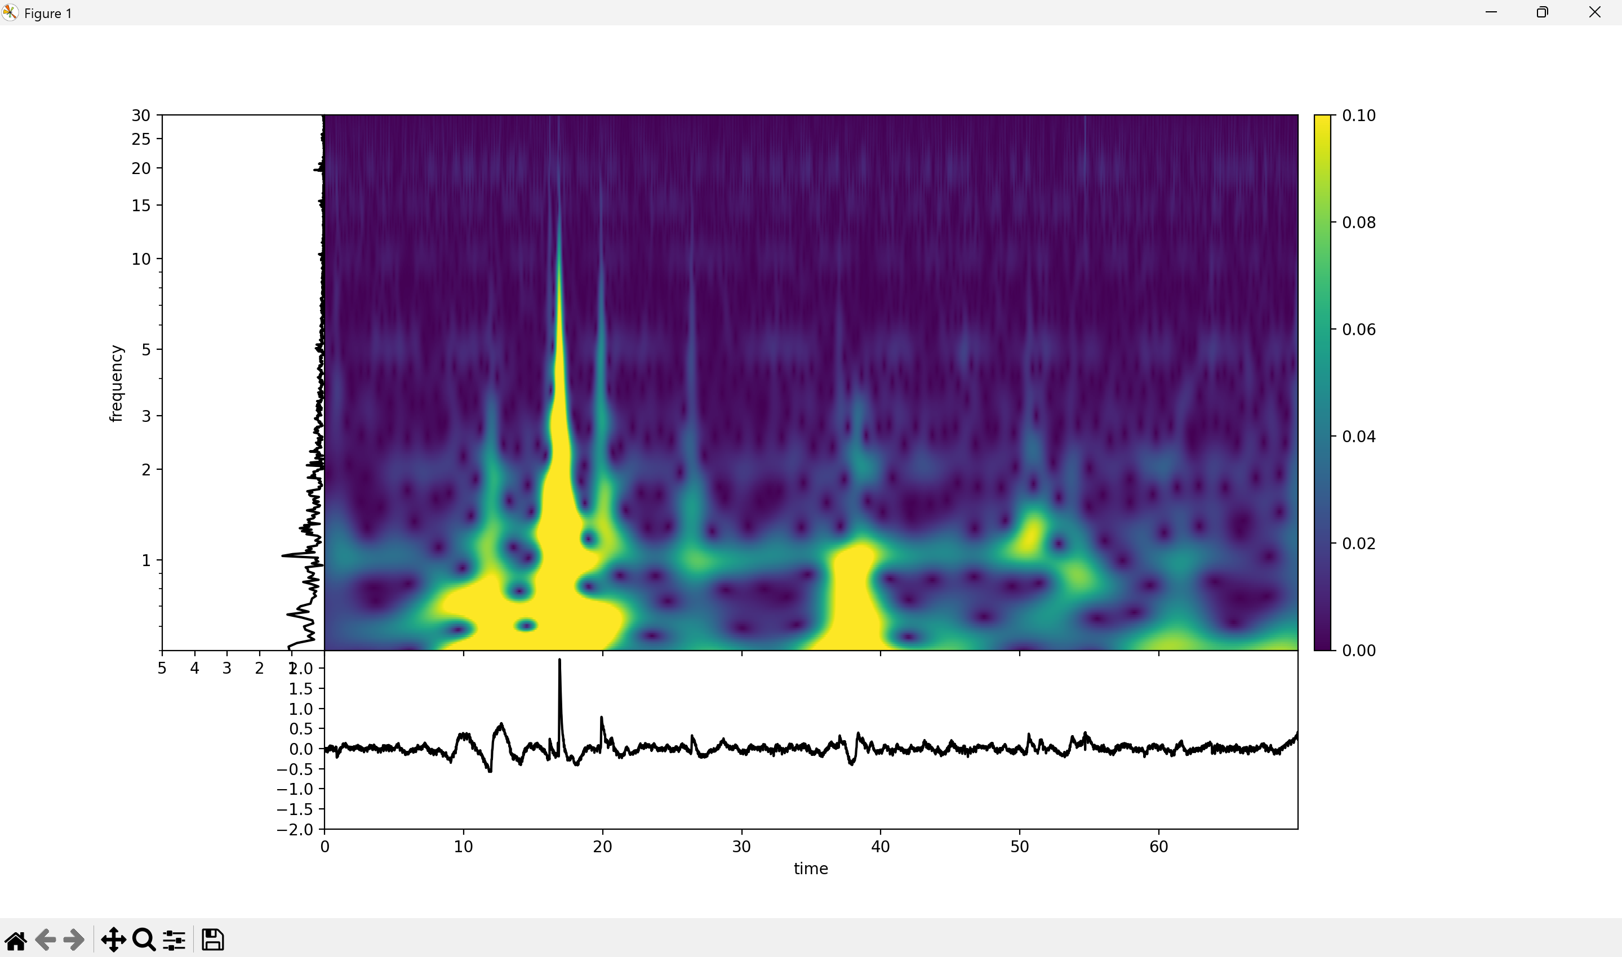
Average Foot Pinch TFR

Slide 38



Compare Average TFRs:
Silence
Stir Whiskers
Pinch Foot

Slide 39
Objective:
Plot the PSD of each recording channel 2 data.
Methods:
I used the extracted channel 2 data from each recording and plotted the PSD using the welch method on traditional logarithmic scale.
Results:
The PSD plots are shown in the following slides.
Observation/Conclusion:
There appear to be consistent spikes at 5, 10, 15 and 20 Hz.
This could be either EEG or 60 Hz harmonic noise
There is a consistent increase in power in frequency bands “in between” spikes.
The recordings with stimulation have higher power in between spikes, recordings with no stimulation have lower power.
This can also be seen as a greater distance between peak and valley in signals.
Next Steps:
Understand how to differentiate between harmonic noise and actual EEG activity of interest.
Find relevant literature or plots that others have created to demonstrate the differences between the two.

Slide 40
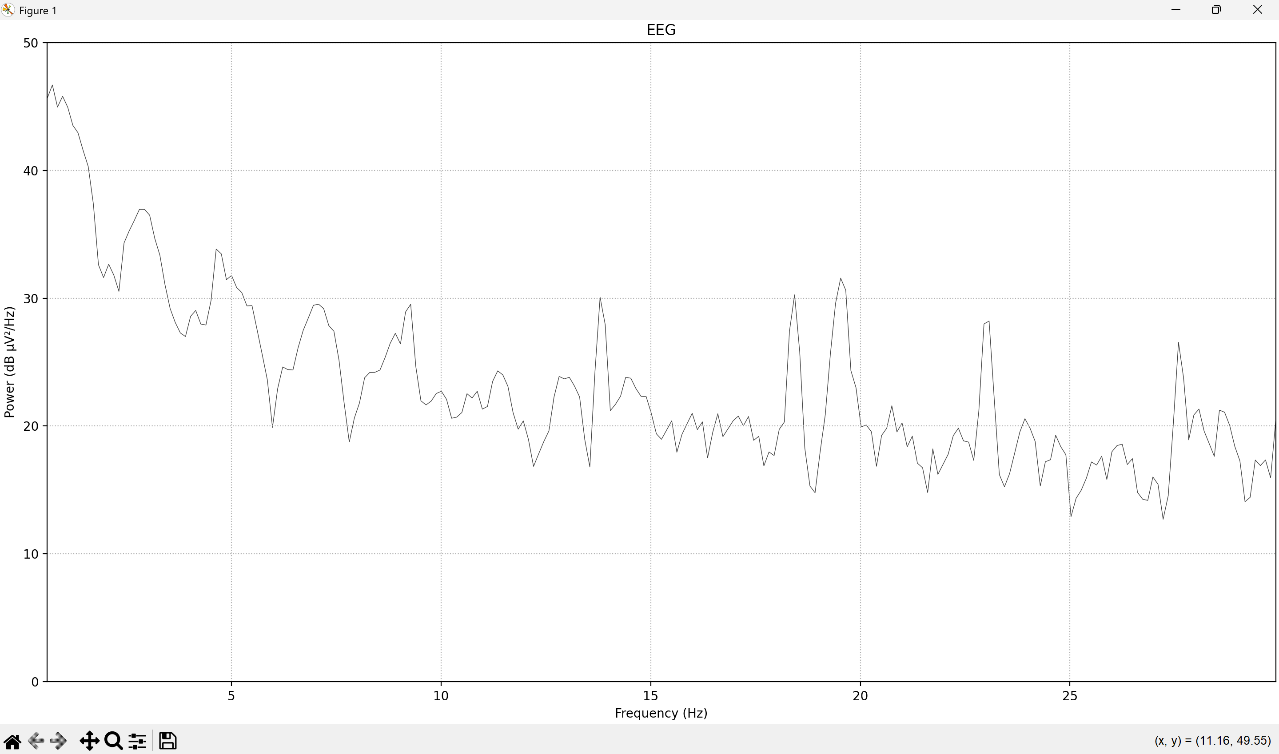
PSD of SDS00002.csv: Silence

Slide 41
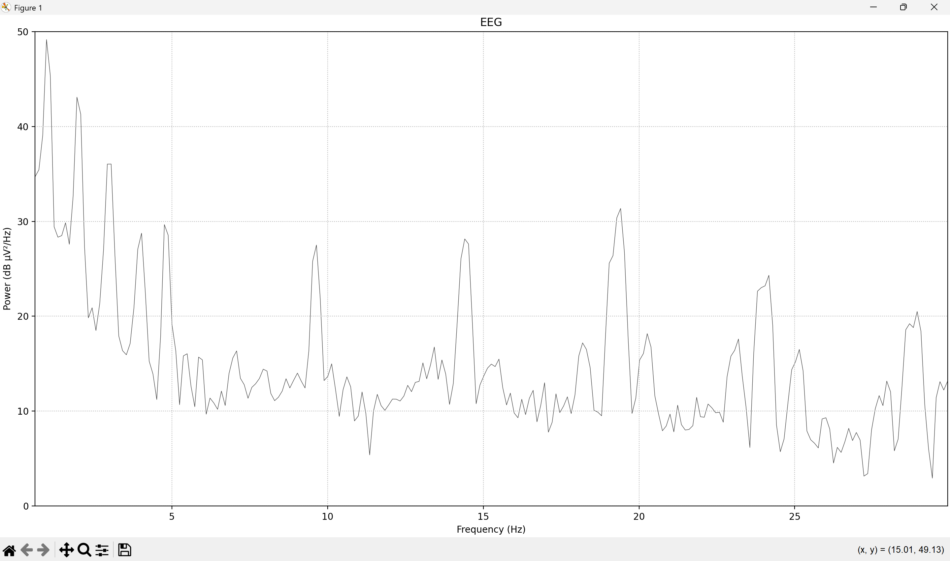
PSD of SDS00003.csv: Silence

Slide 42
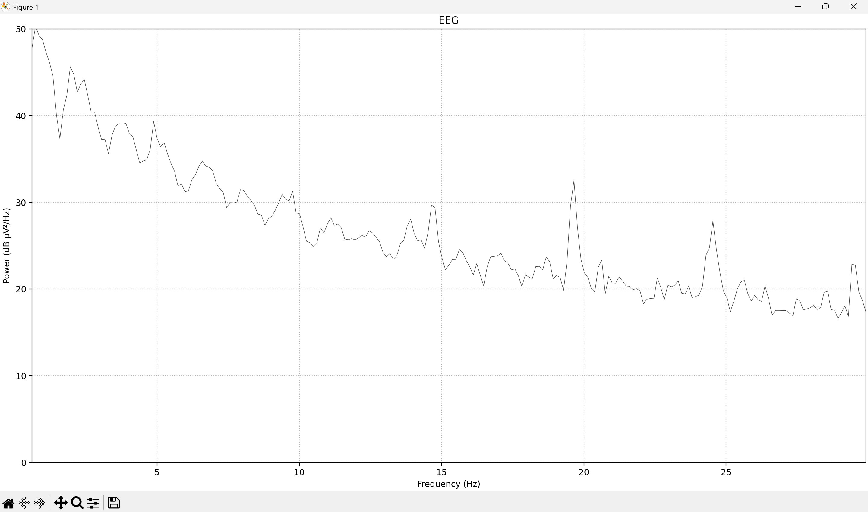
PSD of SDS00004.csv: Stir Whiskers

Slide 43
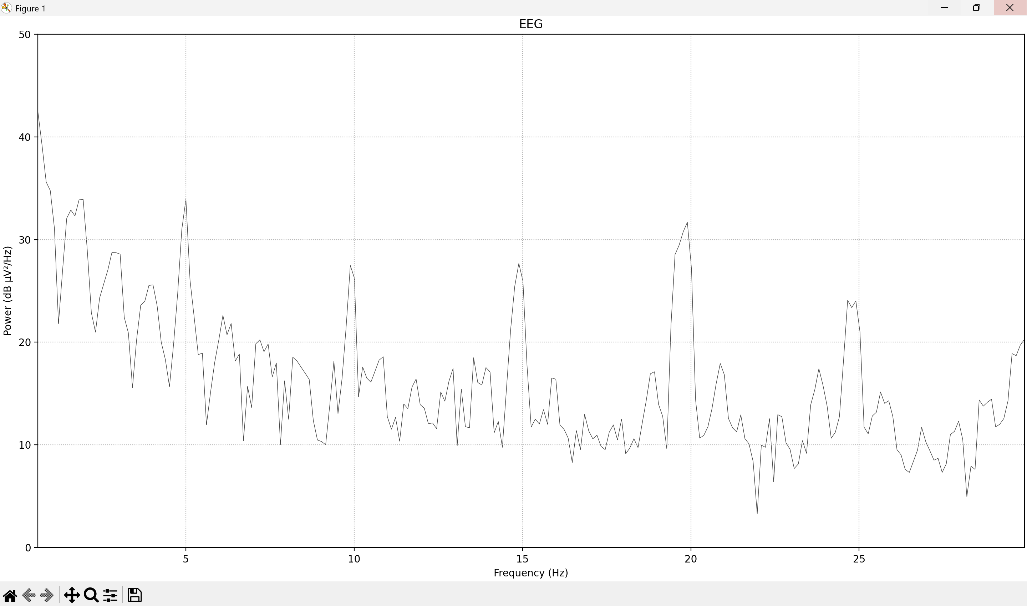
PSD of SDS00005.csv: Stir Whiskers

Slide 44
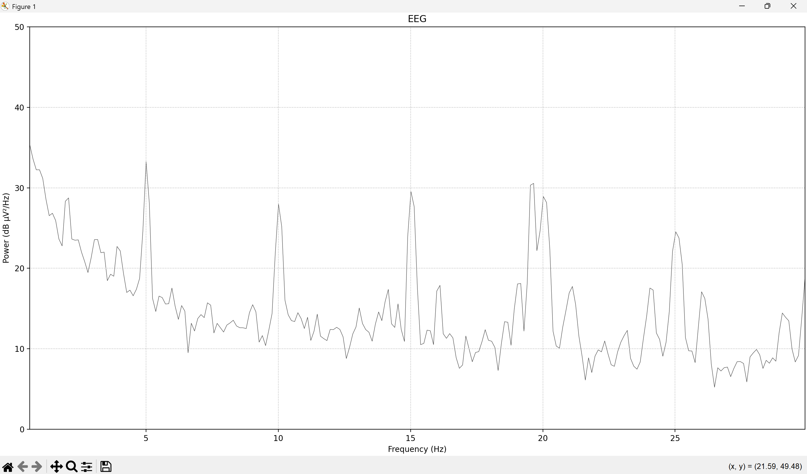
PSD of SDS00006.csv: Silence

Slide 45
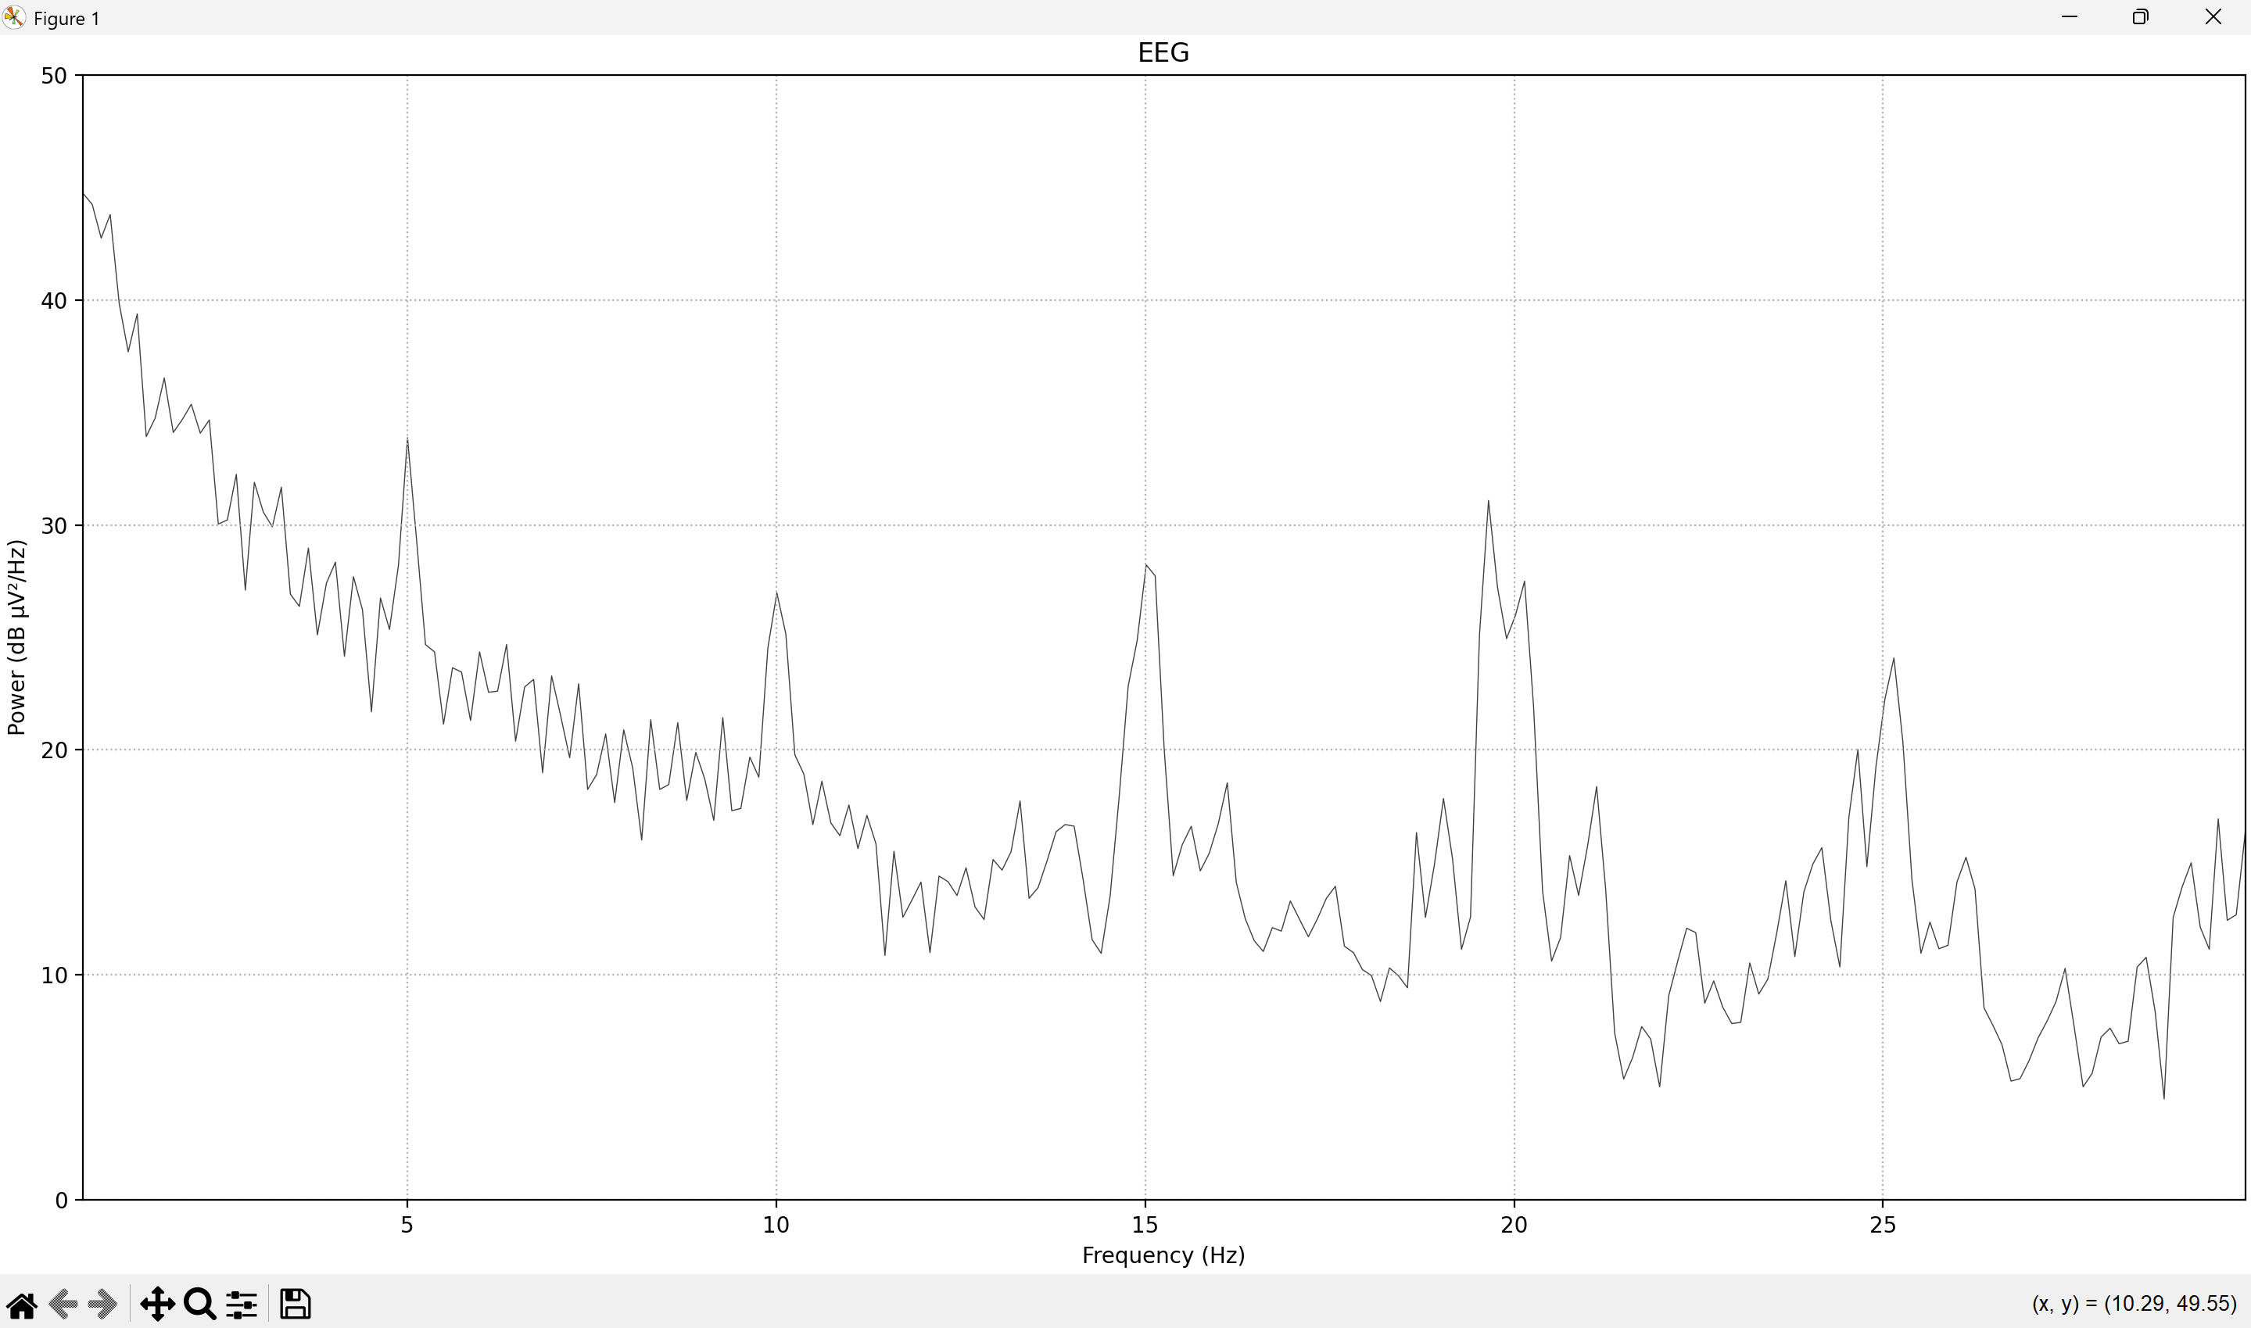
PSD of SDS00007.csv: Pinch Foot

Slide 46
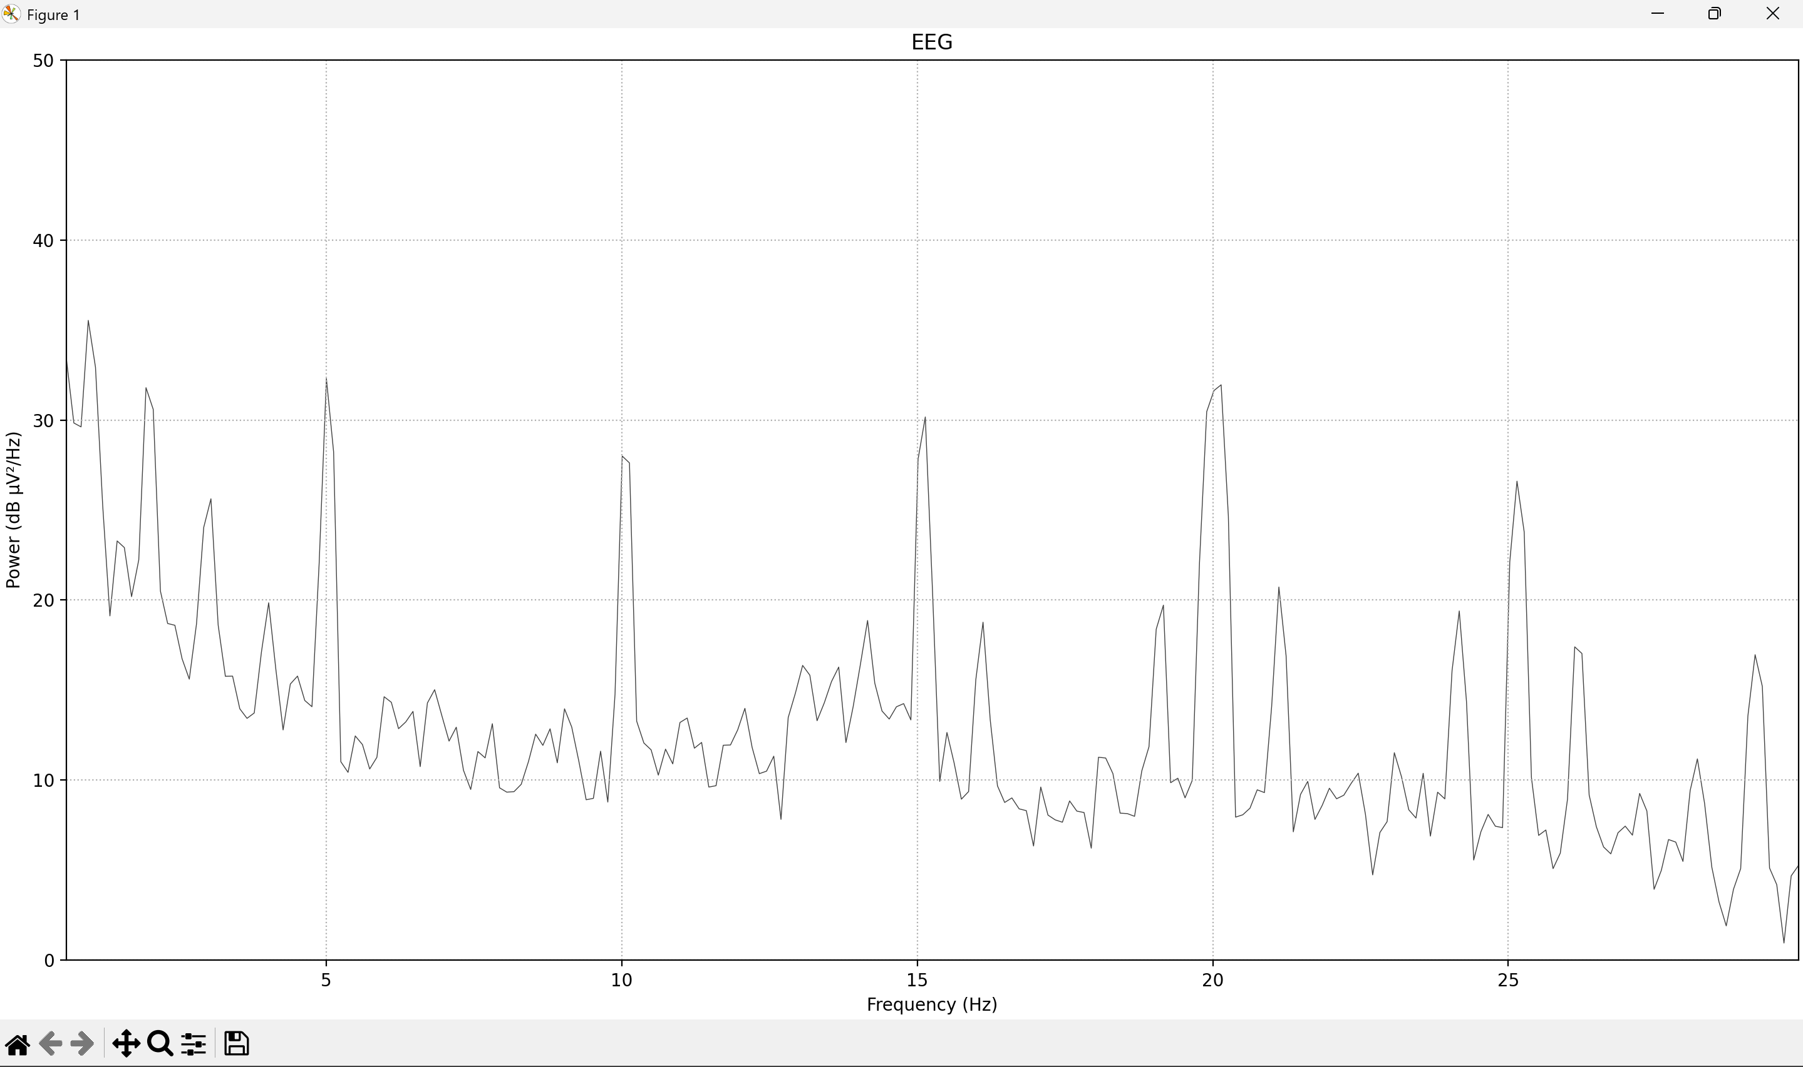
PSD of SDS00008.csv: Silence

Slide 47
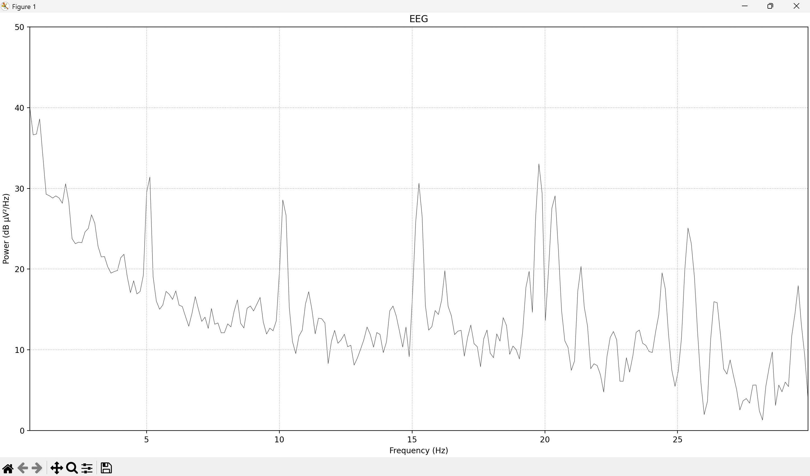
PSD of SDS00009.csv: Stir Whiskers

Slide 48
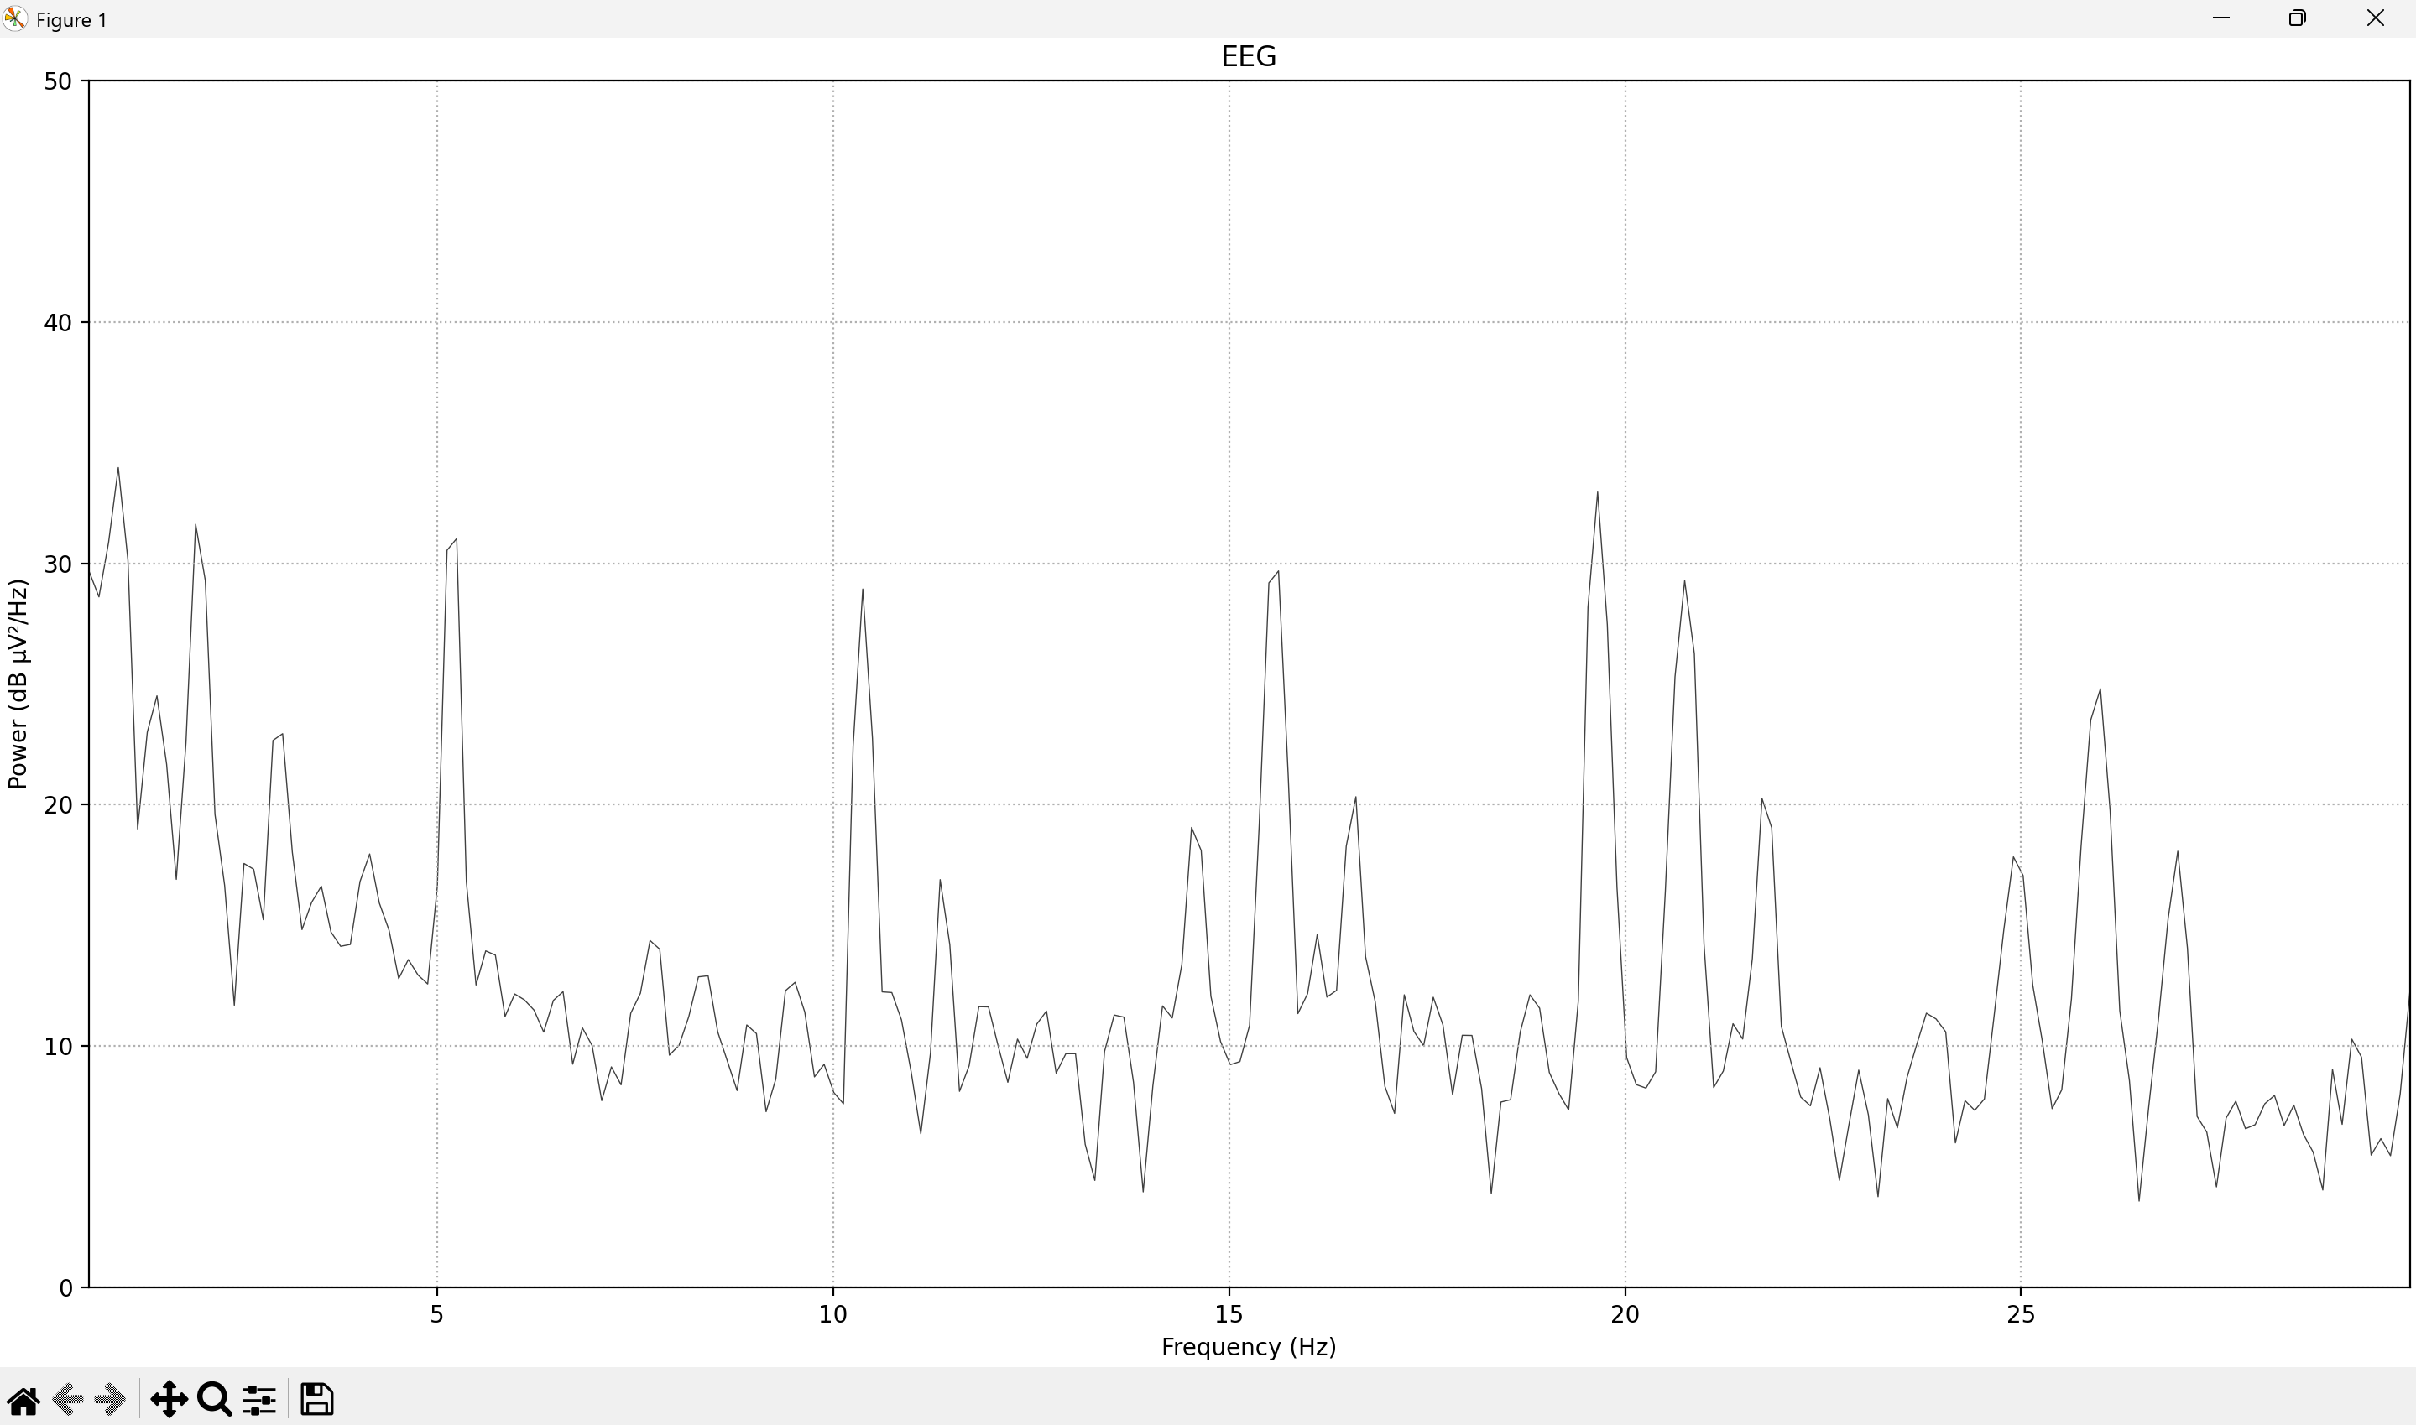
PSD of SDS00010.csv: Silence

Slide 49
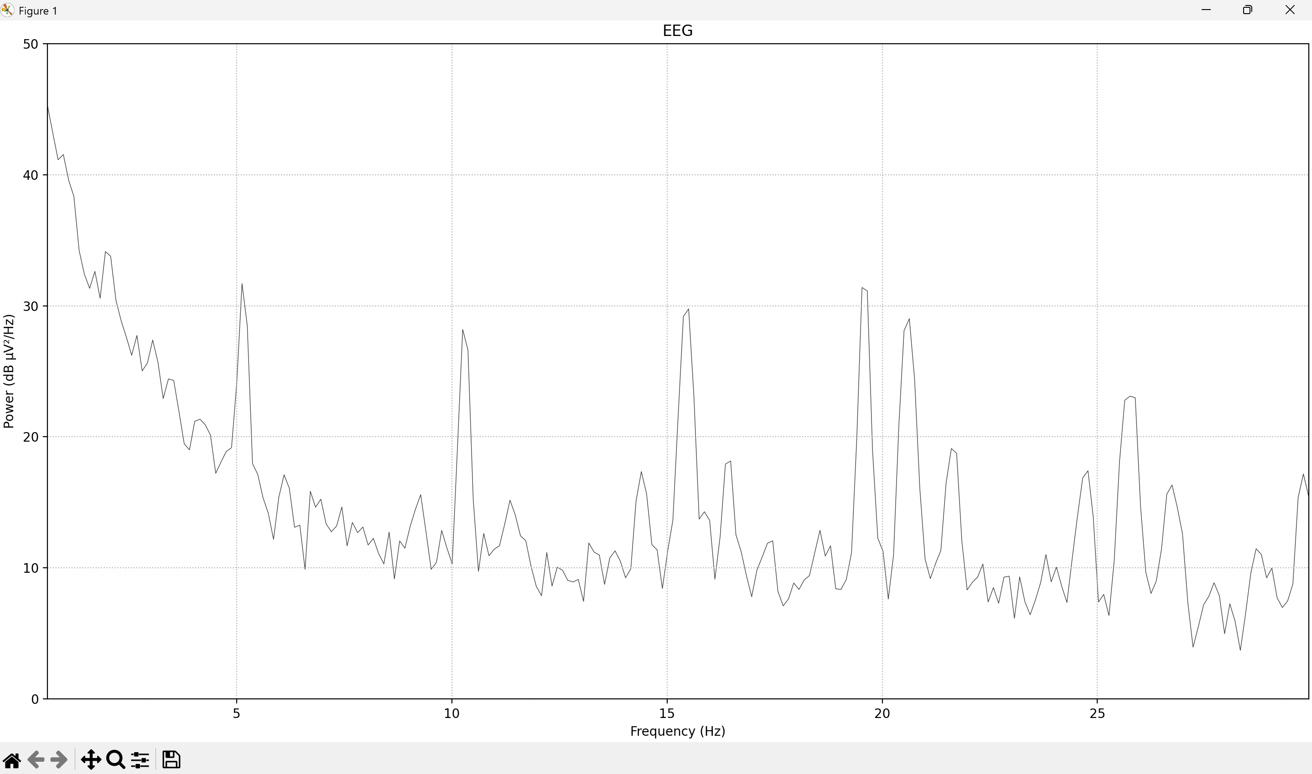
PSD of SDS00011.csv: Pinch Foot

Slide 50
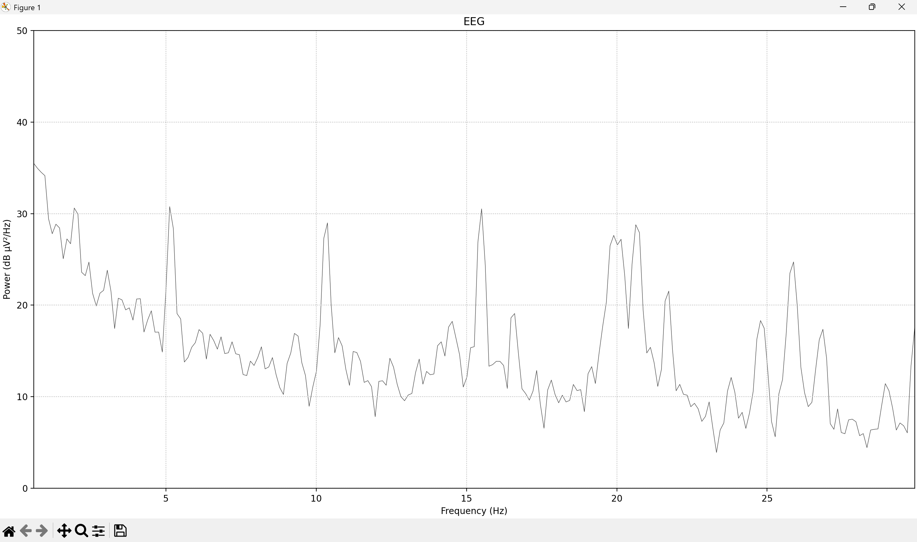
PSD of SDS00012.csv: Silence

Slide 51
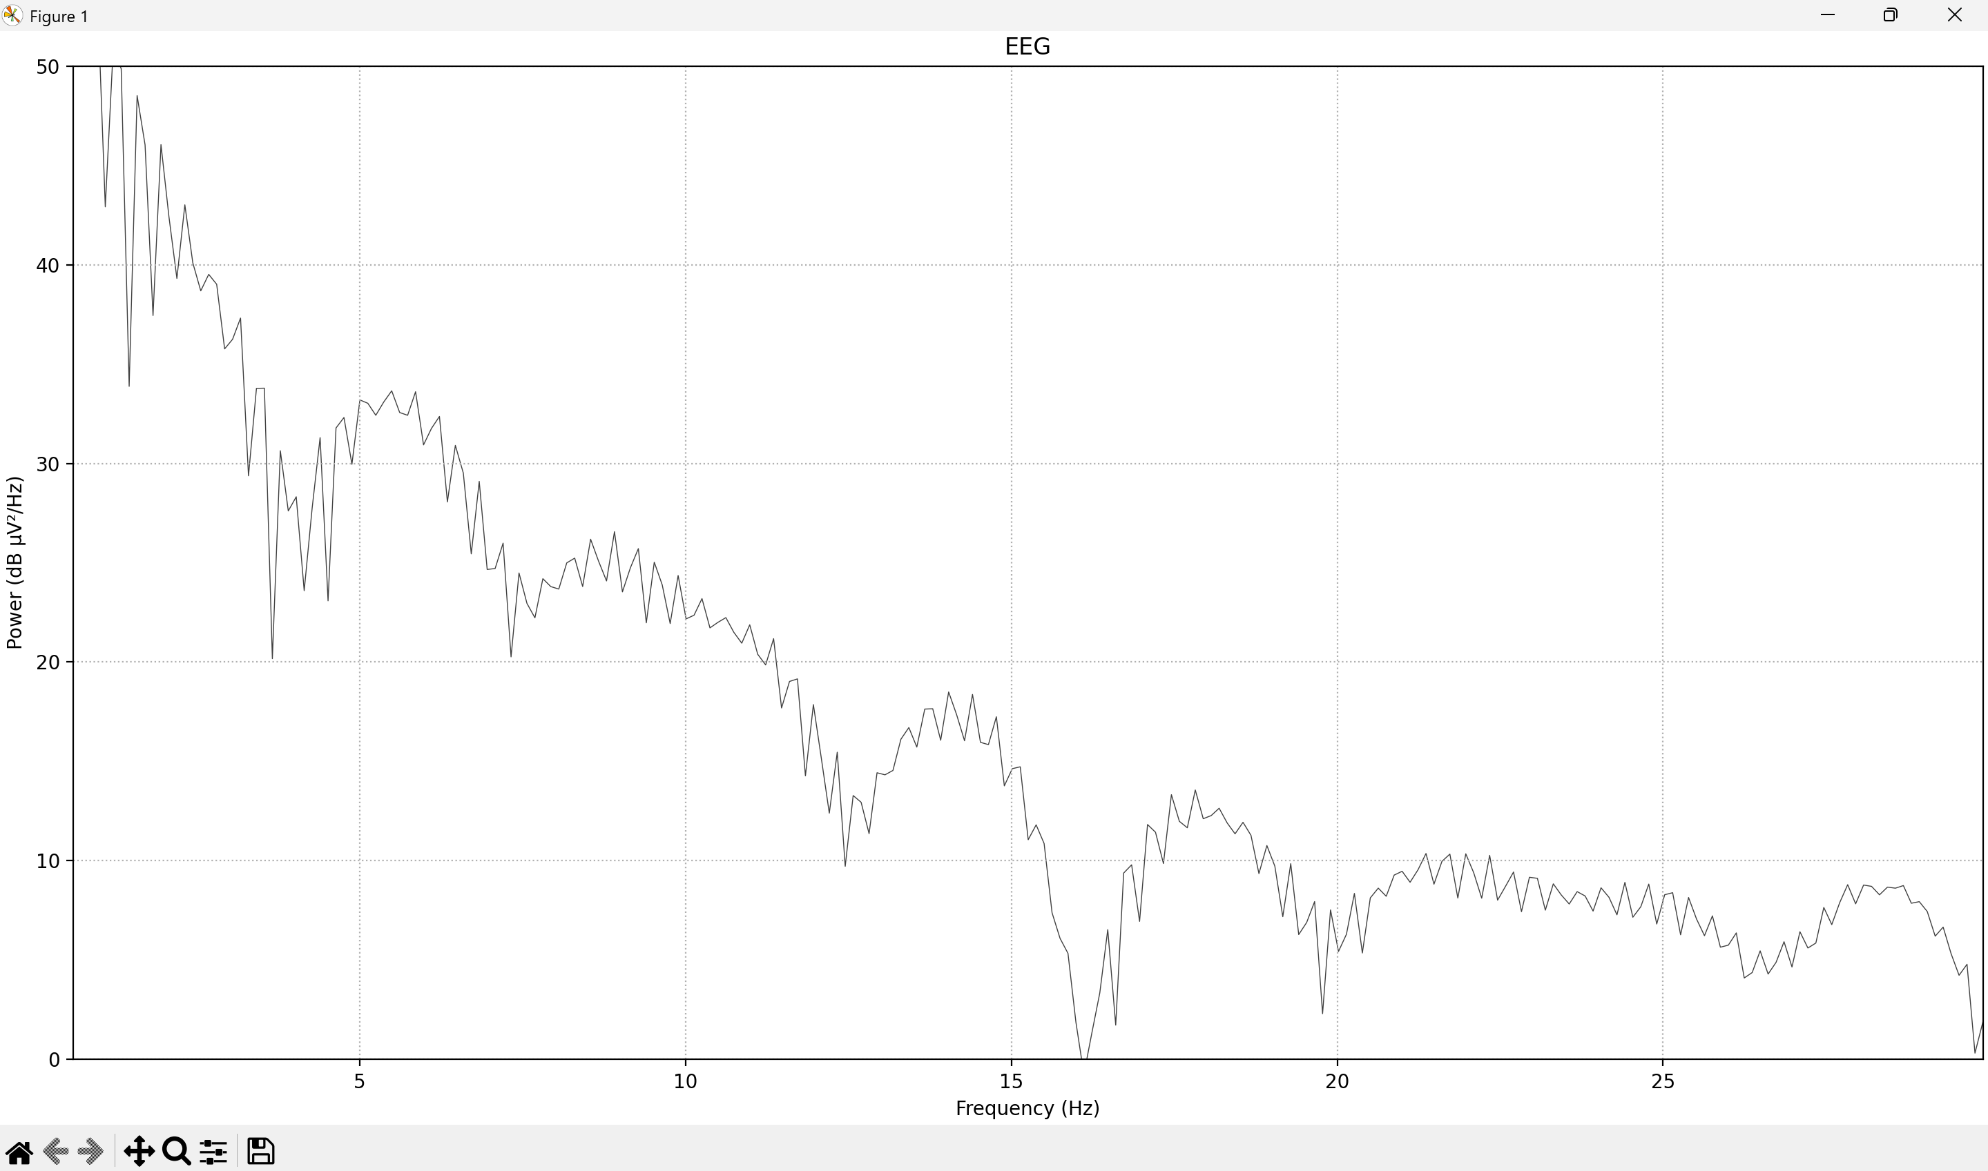
PSD of SDS00013.csv: No rat

Slide 52
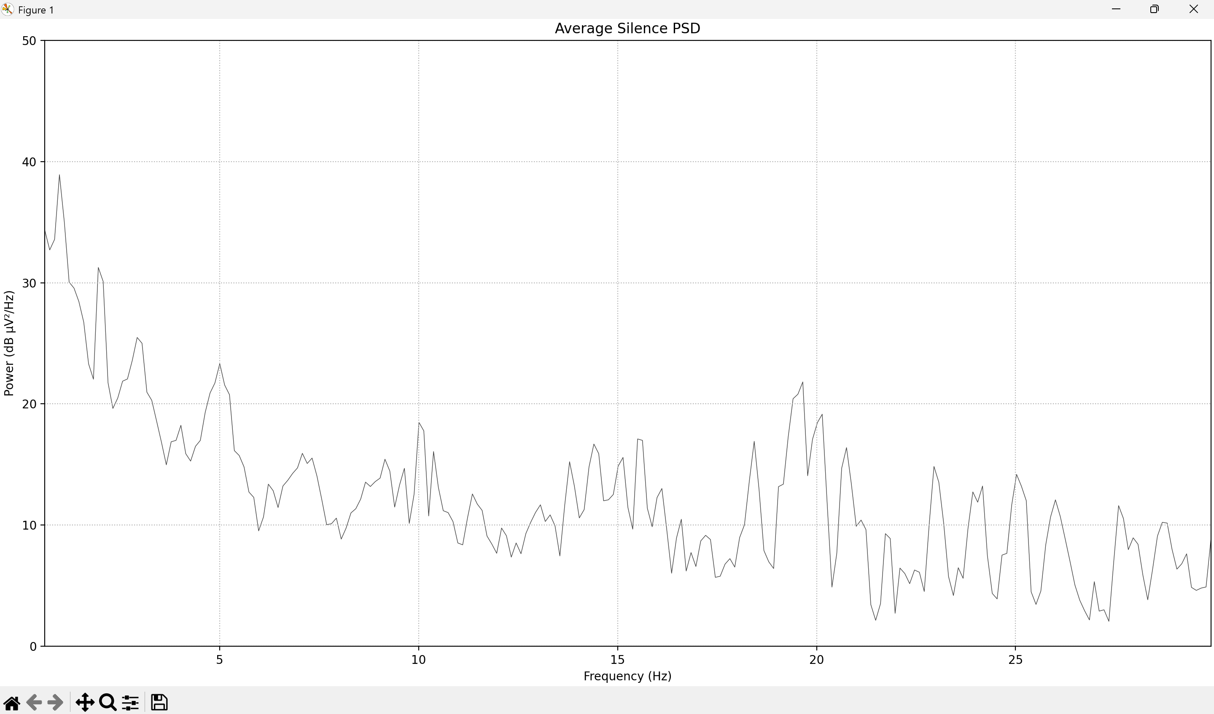
Average of Silence PSD:

Slide 53
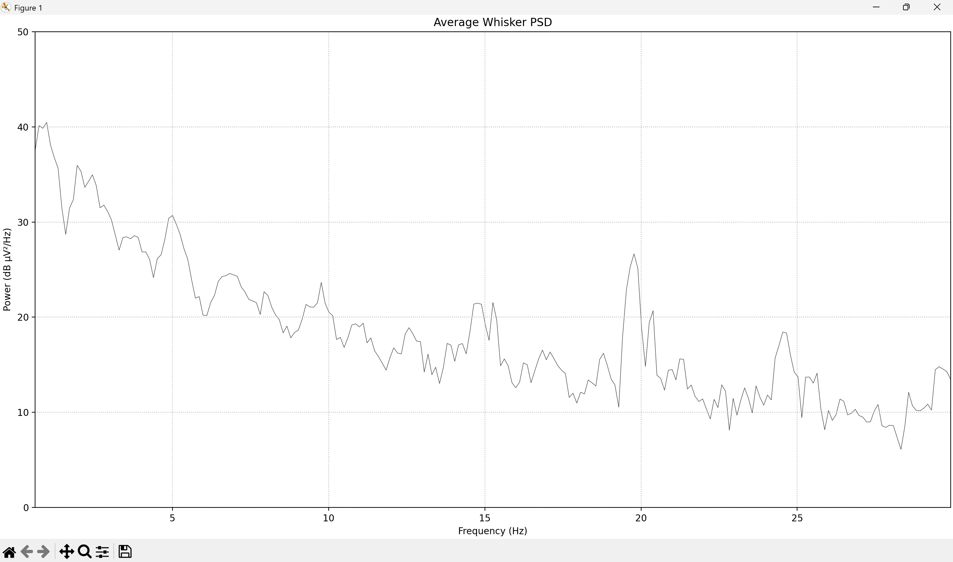
Average of Whisker PSD:

Slide 54
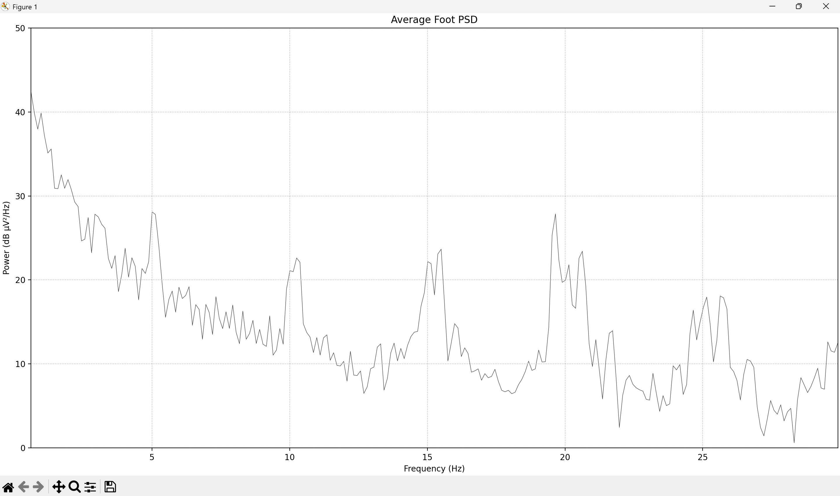
Average of Foot PSD:

Slide 55
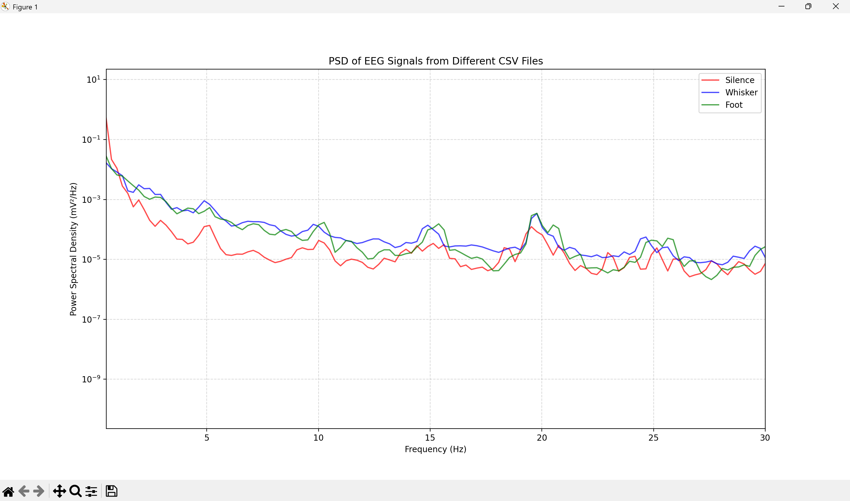
Overlapping averages:

Slide 56
2/3/25 Meeting
Plotting Intan files, comparing to previous recordings, analysis

Slide 57
Objective
Surgery:
Surgeon: Sofia (lead), Anvi, Yitong to place screws for EEG
EEG recording
People: Han
Record EEG signal from anesthetized (iso) rats with the objective of seeing difference between “rest” and “mechanical stimulation” in the EEG data.
Staining
People: Yitong and Melanie
Target SNpC and thalamus brain regions using stained rod/electrode
Use stereotaxic instead of neuroglider

Slide 58
Details on Animal
Date: 1/21/25
Animal ID: 27
Cage #: 1471670
Age: 158 days
Gender: female

Slide 59
Surgical Log
Time | Flowrate (O2) | Resp | Breath Depth | Reflexes | Iso % | rectal temp (C)
0:00 | 770 | 1 Hz | normal | none | 2.8 | 34
0:15 | 770 | 1Hz | normal | none | 2.7 | 33.9
0:30 | 770 | 1hz | normal | none | 2.7 | 33
0:45 | 770 | 1 Hz | normal | none | 2.7 | 33.3
1:00 | 770 | 1 Hz | normal | none | 2.7 | 33.4
1:15 | 770 | 1hz | normal | none | 2.7 | 33
1:30 | 770 | 1hz | normal | none | 2.7 | 32.7
1:45 | 770 | 1hz | normal | none | 2.7 | 32.7
2:00 | 770 | 1hz | normal | None | 2.7 | 32.7
2:15 | 770 | 1 Hz | normal | none | 2.7 | 32.7
2:30 | 770 | 1 Hz | normal | none | 2.7 | 32.7
2:45 | 770 | 1 Hz | normal | none | 2.7 | 32.7
3:00
3:15
3:30
3:45
4:00
4:15
Induction start:3:31 Stereotaxic start: 3:40

Slide 60
Observations
During surgery:
Rat’s breathing was fast and the tone was not normal, so we induced the rat again. Second time the rat was doing better
Decreased iso after ear bars placement to increase breathing rate a little
Temperature probe was difficult to keep in
The rats temperature was lower than normal because of the ambient air, the pad was set to 45 C.
Injected: L , R, L SnPc, R SnPc
Rod was coated after each injection
.28” rod used for injection
What to improve for next surgery:
Work on ear bar placement for Anvi
Speeding up brain extraction
Make burr hole larger, improve dura removal
Sharpen rod, use smaller electrode
Use neural glider

Slide 61
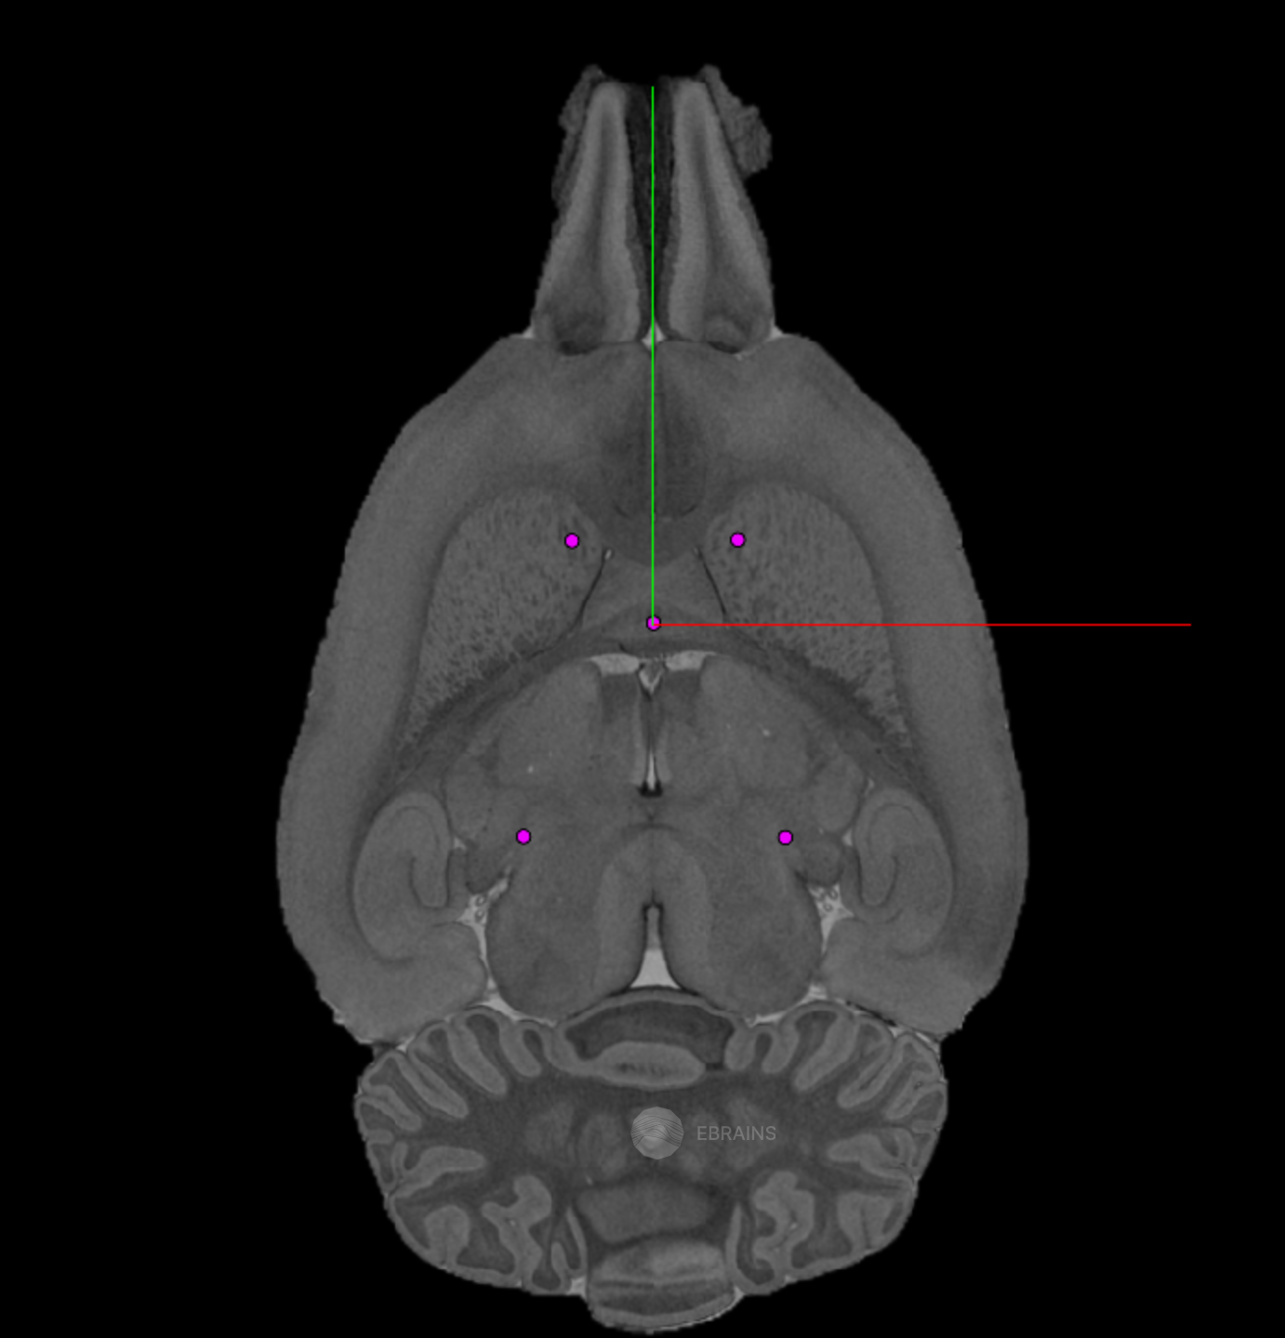
Surgery Plan
Coordinate:
ML (x) : -1.8 mm
AP (y) : 1.8 mm
DV (z): -4 mm
Bregma
Coordinate:
ML (x) : -1.8 mm
AP (y) : 1.8 mm
DV (z): -4 mm
Used hole from pervious experiment and matched its position on the right hemisphere
Target: SNPc
Coordinate:
ML (x):-2.829 mm
AP (y): -4.629mm
DV (z) : -7.274mm
Target: SNPc
Coordinate:
ML (x):2.829 mm
AP (y): -4.629mm
DV (z) : -7.274mm
Notes:
Coordinates used are from Waxholm brain atlas of sprague dawley at 80 days old.

Slide 62
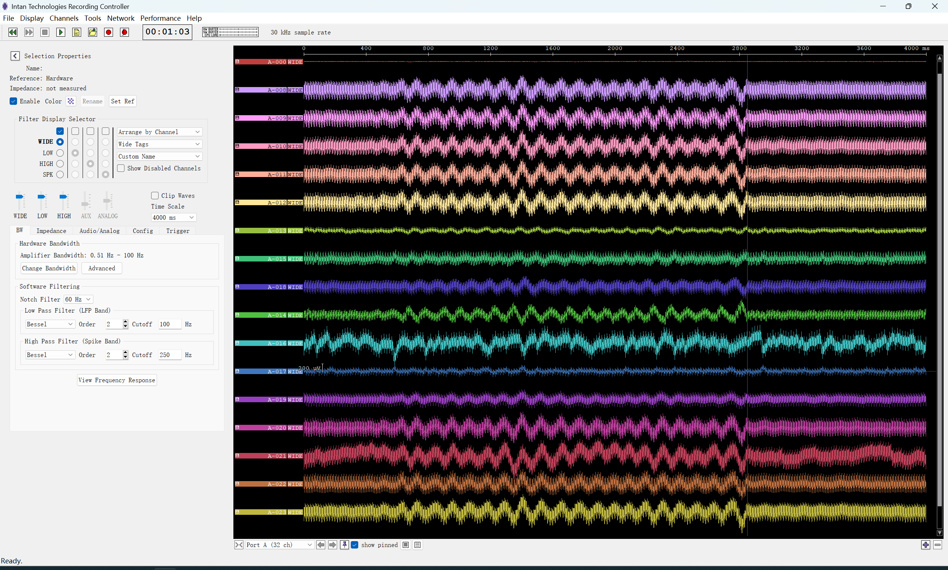
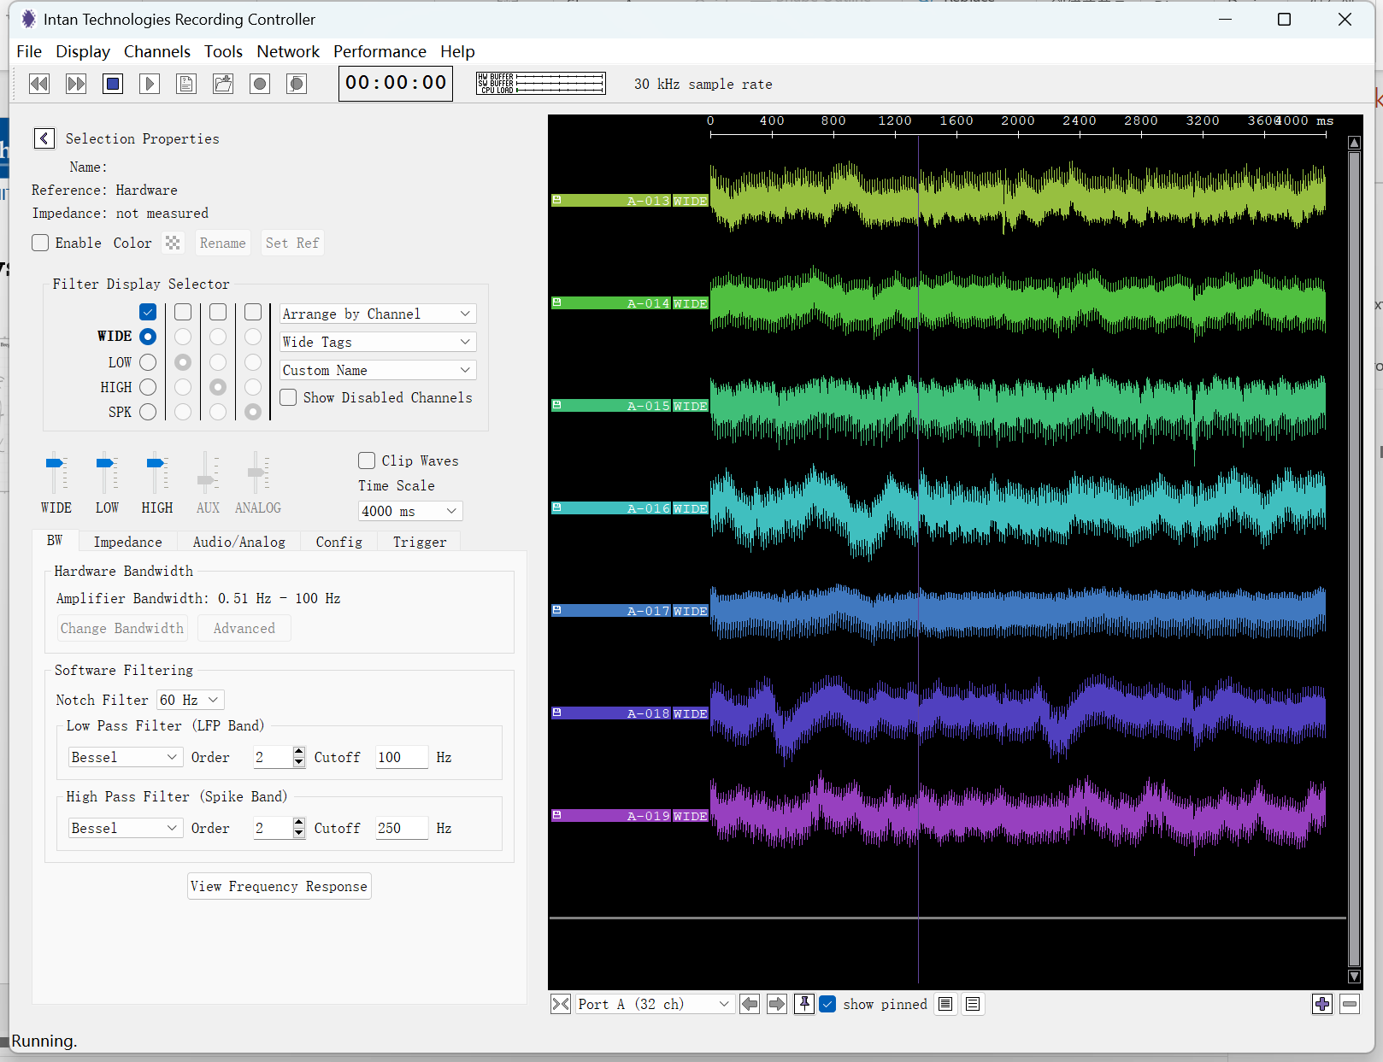
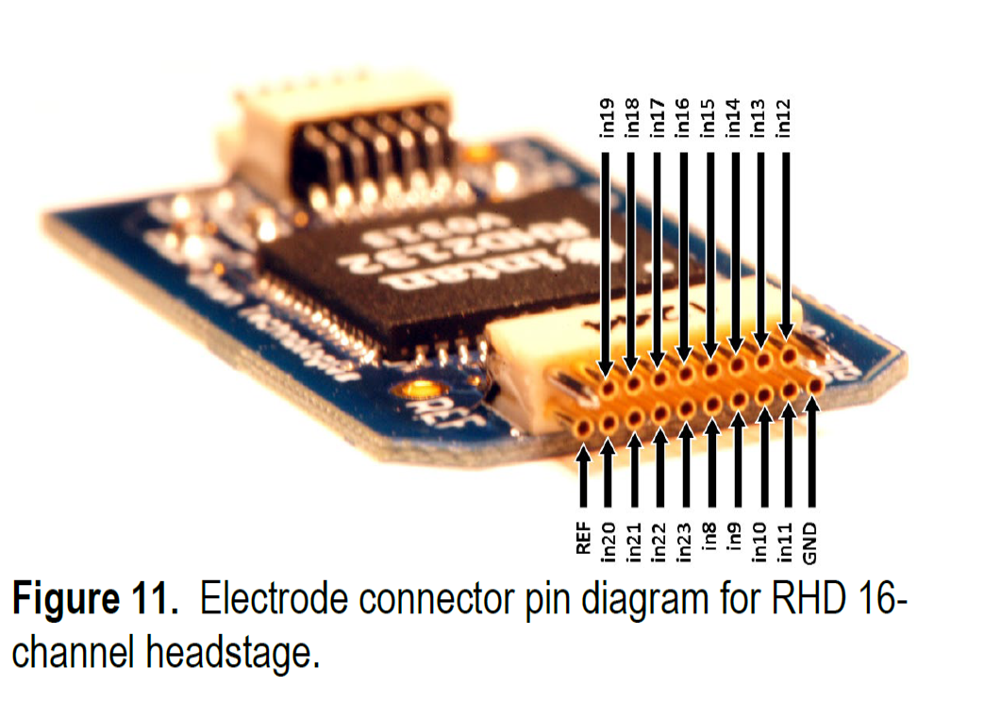
Objective: Setup of INTAN system
Final settings
Start settings
Options | AMP BW (Hz) | No of channel | Notch | Ref
1 | 0.5-100 | 4 | 60Hz | Hardware (short to gnd and subskin)
2 | 0.5-100 | 4 | 60Hz | Average
Ch13 – Ch 19 are connected
Only 19 17 16 14 13 are used
Chassis gnd to signal gnd and then to the earth gnd

Slide 63
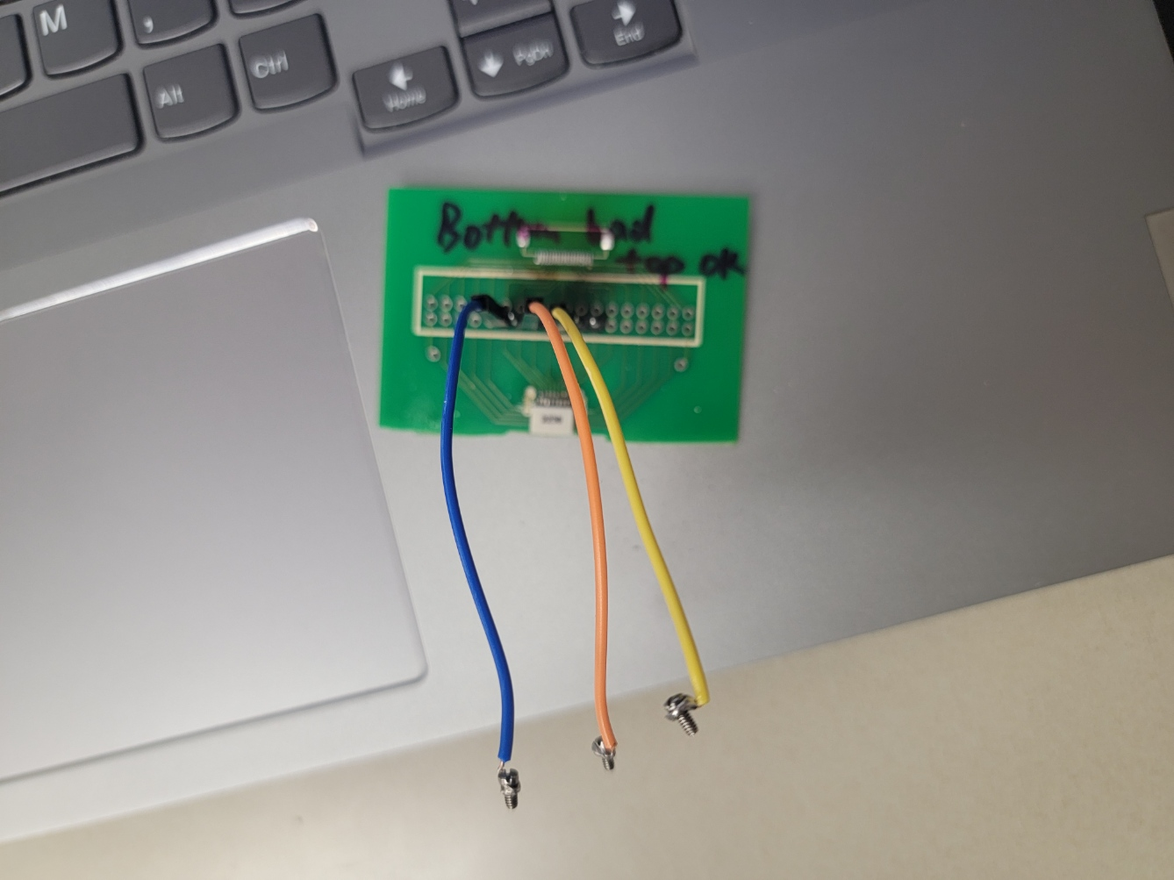
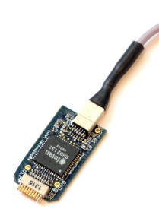


Objective: Setup of INTAN system
INTAN
Ref short to GND on headstage; and then inject to the rat skin (around neck)
Screw Positions
Channel number | Color of cables | Coordinate | Region | Purpose
13 | yellow | ML-5.38 AP+1.16 | S1ULp | Should be right whiskers, error on drilling
14 | Orange | ML-2 AP2 | Edge of FrA and cc | Not designed for this, error on drilling
16 | Blue | ML-2 AP-1.5 | S1HL | Right foot
17 | Red | ML+3 AP+5 | FrA | Possible Ref
19 | Black | ML+5 AP-2.5 | S1BF | Left whiskers

Slide 64

Objective: Screw positions
Reference(FrA)
Designed Coordinates
Region | Ch1 left whisker | Ch2 right whisker | Ch3 right foot | Ch4 ref(far from ch1-3)
ML | 5 | -5 | -2 | 3
AP | -2.5 | -2.5 | -1.5 | 5
DV | Touch dura | Touch dura | Touch dura | Touch dura
S1BF
Ch1: Left whiskers
Ch4 Ref
Screw holes: A little smaller than the screw and then drive it in
Ch3: Right foot
Coordinates used in surgery
Channel number | Color of cables | Coordinate | Region | Purpose
13 | yellow | ML-5.38 AP+1.16 | S1ULp | Should be right whiskers, error on drilling
14 | Orange | ML-2 AP2 | Edge of FrA and cc | Not designed for this, error on drilling
16 | Blue | ML-2 AP-1.5 | S1HL | Right foot
17 | Red | ML+3 AP+5 | FrA | Possible Ref
19 | Black | ML+5 AP-2.5 | S1BF | Left whiskers
S1HL
Ch2

Slide 65
Objective: Steps
2.7% Iso all the way during the recording;
# of Test | Duration | Action | Notes
2 | 90s | Silence; Hardware ref 002
3 | 90s | Silence; AVG ref 003
4 | 90s | Whisker 2 sides, stir+ clamp+light pull 004 | wait 10s and then start 5s +5s rest keep until 90s (10-15stim 16-20 rest, 21-25 stim… and repeat)
5 | 60s | Silence avg ref 005
6 | 90s | Foot pinch 006 | Wait 10s, then foot pinch once at 11s, then 16-20s stim, 21-25 rest, 26-30 stim… then repeat until the end
7 | 106s | Silence 007
8 | 102s | Whisker 008 | Wait 10s, 10-15 stim; 45-50stim; 1:30-1:35 stim Others all rest
9 | 30s | Silence 009
10 | 90s | Silence; Add more blank channels 010 | Ch0: no headstage; ch20-23: no pins out, but on the headstage and adapter board
11 | 90s | Foot pinch011 | Wait 10s, 10-15stim 45-50stim 1:30-1:35 stim Others all rest
12 | 100s | Silence 012
13 | 60s | No connection, only the headstage, in ESD bag, 013 | Touch the table at last few seconds
14 | 60s | No connection, only the headstage, in ESD bag, all channels on, 014 | Touch the table at last few seconds

Slide 66


Title: ssEEG Project
Objective: Surgery Summery
Results:1. Use INTAN recorder 2. Better results
Results
03
04
Align with the stimulation
03 | Silence; AVG ref 003
04 | Whisker 2 sides, stir+ clamp+light pull 004 | wait 10s and then start 5s +5s rest keep until 90s (10-15stim 16-20 rest, 21-25 stim… and repeat)

Slide 67


Title: ssEEG Project
Objective: Surgery Summery
Results:1. Use INTAN recorder 2. Better results
Results
05
06
05 | Silence avg ref 005
06 | Foot pinch 006 | Wait 10s, then foot pinch once at 11s, then 16-20s stim, 21-25 rest, 26-30 stim… then repeat until the end

Slide 68


Title: ssEEG Project
Objective: Surgery Summery
Results:1. Use INTAN recorder 2. Better results
Results
07
08 Align with the stimulation
07 | Silence 007
08 | Whisker 008 | Wait 10s, 10-15 stim; 45-50stim; 1:30-1:35 stim Others all rest

Slide 69



Title: ssEEG Project
Objective: Surgery Summery
Results:1. Use INTAN recorder 2. Better results
Results
10
11
12
10 | Silence; Add more blank channels 010 | ch20-23: no pins out, but on the headstage and adapter board
11 | Foot pinch011 | Wait 10s, 10-15stim 45-50stim 1:30-1:35 stim Others all rest
12 | Silence 012

Slide 70



Objective: Refs
A Temporal–Spatial Atlas of Peripheral Nerve Evoked Cortex Potential in Rat: A Novel Testbed to Explore the Responding Patterns of the Brain to Peripheral Nerves
Methodological standards and interpretation of video-electroencephalography in adult control rodents. A TASK1-WG1 report of the AES/ILAE Translational Task Force of the ILAE

Slide 71
Objective:
Retrieve Intan data and transfer to .csv file format
Methods:
I used given read_Intan file to process the data in Matlab and utilized the csvwrite() function to convert data into a usable format. From there, I was able to convert into a dataset that could be processed and filtered in eeglab.
Results:
The data was successfully converted from an intan file format into .csv and then .set& .fdt files for eeglab processing.
Observation/Conclusion:
There are 7 channels (expected) in the first 9 files, but the last 5 files have 12 channels.
Next Steps:
Plot the time series representation of filtered data.

Slide 72

Recording 2:Silence

Slide 73

Recording 3:Silence

Slide 74

Recording 4: Whisker

Slide 75

Recording 5:Silence

Slide 76

Recording 6: Foot pinch

Slide 77

Recording 7: Silence

Slide 78

Recording 8:Whisker

Slide 79

Recording 9:Silence

Slide 80

Recording 10:Silence

Slide 81

Recording 11:Foot Pinch

Slide 82

Recording 12:Silence

Slide 83

Recording 13:No connection

Slide 84

Recording 14: No connection

Slide 85
Objective:
Plot time series representations of filtered data
Methods:
I used eeglab to process the data. Since the hardware already had a 60Hz notch filter, I did not add any other filter to remove 60 Hz noise. I visually rejected large artifacts, downsampled the data to 250 Hz, applied a 0.5-30 Hz bandpass filter, applied ICA to remove more artifacts, and applied a moving average to the data.
Results:
The data was successfully cleaned and some patterns may be visible, but are not consistent.
Observation/Conclusion:
There are 7 channels (expected) in the first 9 files, but the last 5 files have 12 channels.
Next Steps:
Plot the TFR representation of filtered data.

Slide 86
Filtered Time series plots

Slide 87

Recording 2, stacked: Silence, hardware reference

Slide 88

Recording 2, spread: : Silence, hardware reference

Slide 89

Recording 3, stacked: Silence, average reference

Slide 90

Recording 3, spread: Silence, average reference

Slide 91

Recording 4, stacked: Whisker pull on both sides

Slide 92

Recording 4, spread: Whisker pull on both sides

Slide 93

Recording 5, stacked: Silence

Slide 94

Recording 5, spread: Silence

Slide 95

Recording 6, stacked: Foot pinch

Slide 96

Recording 6, spread: Foot pinch

Slide 97

Recording 7, stacked: Silence

Slide 98

Recording 7, spread: Silence

Slide 99

Recording 8, stacked: Whisker Stimulation

Slide 100

Recording 8, spread: Whisker Stimulation

Slide 101

Recording 9, stacked: Silence

Slide 102

Recording 9, spread: Silence

Slide 103

Recording 10, stacked: Silence, with more channels

Slide 104

Recording 10, spread: Silence

Slide 105

Recording 11, stacked: Foot pinch

Slide 106

Recording 11, spread: Foot pinch

Slide 107

Recording 12, stacked: Silence

Slide 108

Recording 12, spread: Silence

Slide 109

Recording 13, stacked: No connection, only headstage

Slide 110

Recording 13, spread : No connection, only headstage

Slide 111

Recording 14, stacked: No connection, only headstage

Slide 112

Recording 14, spread: No connection, only headstage

Slide 113
Objective:
Plot TFR data of all recordings
Methods:
I used Python to plot each relevant channel individually to analyze the TFR across each channel per each stimulation
Results:
The stimultation plots show some response consistent with stimulation.
Silence plots are still inconsistent.
Observation/Conclusion:
There may be some repeatability, but it is still not consistent.
Next Steps:
Understand the relationship between the channel and measured response with regard to stimulation.
Plot the Power spectral density of each recording

Slide 114
Time Frequency Response (TFR) Plots from Channel 1: A-013, focused on right whiskers

Slide 115

Recording 2: Silence

Slide 116

Recording 3: Silence

Slide 117

Recording 4: Whisker Stimulation

Slide 118

Recording 5: Silence

Slide 119

Recording 6: Foot pinch

Slide 120

Recording 7: Silence

Slide 121

Recording 8: Whisker stimulation

Slide 122

Recording 9: Silence

Slide 123

Recording 10: Silence

Slide 124

Recording 11: Foot pinch

Slide 125

Recording 12: Silence

Slide 126

Recording 13: No connection

Slide 127

Recording 14: No connection

Slide 128
All silence :
Recording 12
Recording 2
Recording 3
Recording 5
Recording 7
Recording 9
Recording 10

Slide 129
Whisker stimulation:

Slide 130
Foot Pinch:

Slide 131
TFR of Channel 2 (A-014)

Slide 132

Recording 2: Silence

Slide 133

Recording 3: Silence

Slide 134

Recording 4: Whisker

Slide 135

Recording 5: Silence

Slide 136

Recording 6: Foot pinch

Slide 137

Recording 7: Silence

Slide 138

Recording 8: Whisker

Slide 139

Recording 9: Silence

Slide 140

Recording 10: Silence

Slide 141

Recording 11: Foot pinch

Slide 142

Recording 12: Silence

Slide 143

Recording 13: No connection

Slide 144

Recording 14: No connection

Slide 145
All Silence
Recording 12
Recording 2
Recording 3
Recording 5
Recording 7
Recording 9
Recording 10

Slide 146
Whisker Stimulation

Slide 147
Foot pinch

Slide 148
TFR of Channel 4 data (A-016), focused on foot

Slide 149

Recording 2: Silence

Slide 150

Recording 3: Silence

Slide 151

Recording 4: Whisker

Slide 152

Recording 5: Silence

Slide 153

Recording 6: Foot pinch

Slide 154

Recording 7: Silence

Slide 155

Recording 8: Whisker

Slide 156

Recording 9: Silence

Slide 157

Recording 10: Silence

Slide 158

Recording 11: Foot pinch

Slide 159

Recording 12: Silence

Slide 160

Recording 13: No connection

Slide 161

Recording 14: No connection

Slide 163
TFR of Channel 5 data (A-017), reference

Slide 164

Recording 2: Silence

Slide 165

Recording 3: Silence

Slide 166

Recording 4: Whisker

Slide 167

Recording 5: Silence

Slide 168

Recording 6: Foot pinch

Slide 169

Recording 7: Silence

Slide 170

Recording 8: Whisker

Slide 171

Recording 9: Silence

Slide 172

Recording 10: Silence

Slide 173

Recording 11: Foot pinch

Slide 174
Recording 12: Silence

Slide 175

Recording 13: No connection

Slide 176

Recording 14: No connection

Slide 177
TFR of channel 6 (A-019) , focused on whiskers

Slide 178

Recording 2: Silence

Slide 179

Recording 3: Silence

Slide 180

Recording 4: Whisker

Slide 181
Compare Whisker
A-013
A-014
A-016
A-017
A-019

Slide 182

Recording 5: Silence

Slide 183

Recording 6: Foot pinch

Slide 184

Recording 7: Silence

Slide 185

Recording 8: Whisker

Slide 186

Recording 9: Silence

Slide 187

Recording 10: Silence

Slide 188

Recording 11: Foot pinch

Slide 189

Recording 12: Silence

Slide 190

Recording 13: No connection

Slide 191

Recording 14: No connection

Slide 192
Objective:
Plot PSD data of all recordings
Methods:
I used Python to plot each relevant channel individually to analyze the frequency intensity across each channel per each stimulation.
Results:
The first three recordings have more clear spikes in power differences, but later recordings are more evenly dispersed.
Spikes at harmonics are still present.
Observation/Conclusion:
The power density distribution remains consistent with previous representations.
Next Steps:
Understand why only some recordings show individual, defined spikes in power distribution.

Slide 193
Power Spectral Density (PSD) of all channels

Slide 194

Recording 2: Silence

Slide 195

Recording 3: Silence

Slide 196

Recording 4: Whisker

Slide 197

Recording 5: Silence

Slide 198

Recording 6: Foot pinch

Slide 199

Recording 7: Silence

Slide 200

Recording 8: Whisker

Slide 201

Recording 9: Silence

Slide 202

Recording 10: Silence

Slide 203

Recording 11: Foot pinch

Slide 204

Recording 12: Silence

Slide 205

Recording 13: No connection

Slide 206

Recording 14: No connection

